Slide 1
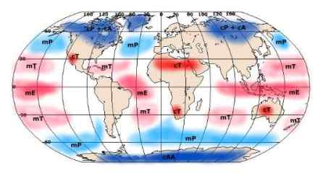
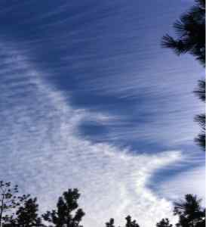
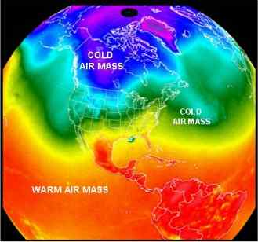
©Mark Place, 2009-2010
www.LearnEarthScience.com
Air Masses

Slide 2
AIR MASSES
What's the definition?
A large body of
air with similar
characteristics
throughout

Slide 3
Air masses are classified based on their
and amount of
temperature
moisture

Slide 4
Air masses get their characteristics based on
where
they
form

Slide 5
The abbreviations used to classify air masses
use the following letters: c, m, T, P, and A.
For each letter, describe its property:
 | Word | Means
c
m
T
P
A
continental
dry
maritime
moist
Tropical
warm
Polar
cold
Arctic
very cold

Slide 6
What would their characteristics be?
mT
cP
warm and moist
cold and dry

Slide 7
High or Low Pressure?
mT
cP
H
L

Slide 8
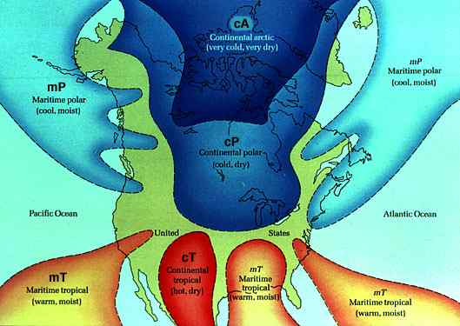

Slide 9
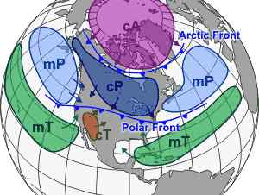

Slide 10
What type of air mass
would form over each
area? Please label.
cA
mP
mP
cP
cT
mT
mT
mT

Slide 11
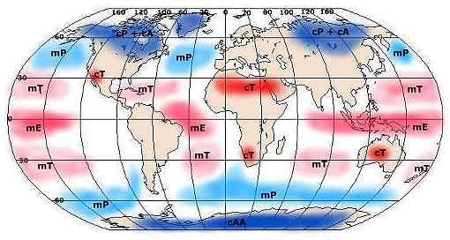
World Air Mass
Source Regions

Slide 13
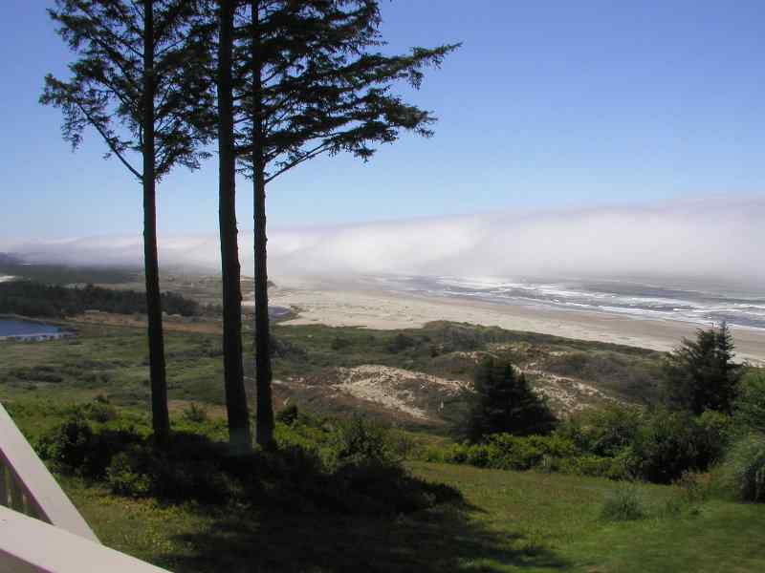

Slide 14
Animation #1
http://www.classzone.com/books/earth_science/terc/content/visualizations/es2001/es2001page01.cfm?chapter_no=20

Slide 15
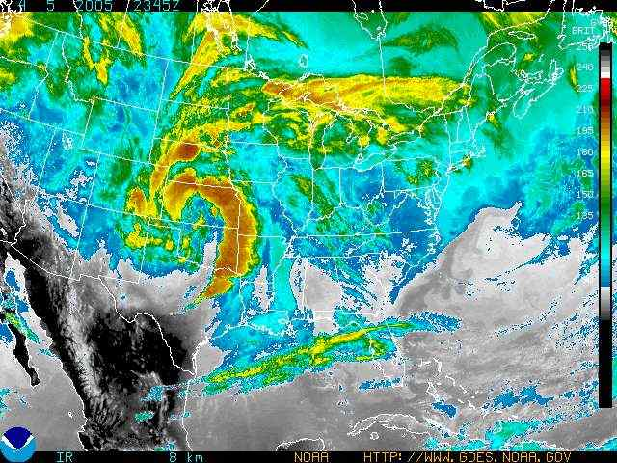
cP air mass
dry, cool air
High Pressure Area
mT air mass
warm, moist air
Low Pressure Center

Slide 16
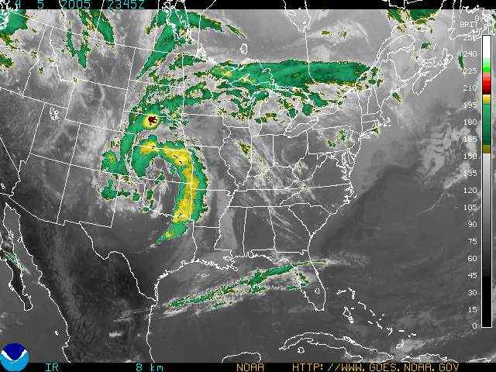
cP air mass
dry, cool air
High Pressure Area
mT air mass
warm, moist air
Low Pressure Center

Slide 17
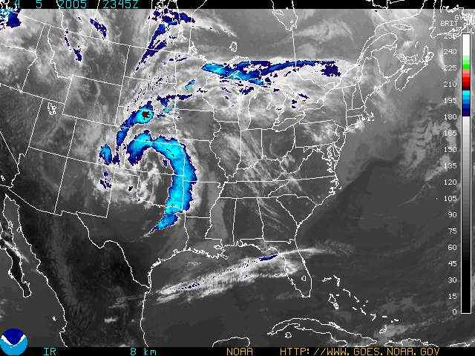
cP air mass
dry, cool air
High Pressure Area
mT air mass
warm, moist air
Low Pressure Center

Slide 18
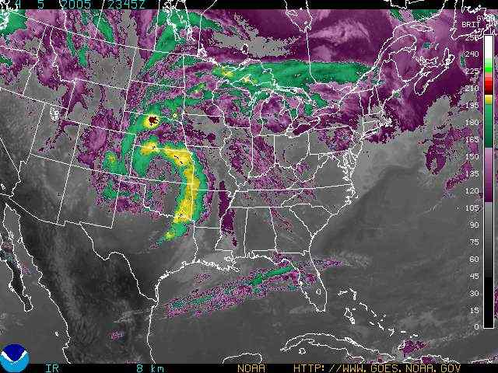
cP air mass
dry, cool air
High Pressure Area
mT air mass
warm, moist air
Low Pressure Center

Slide 19
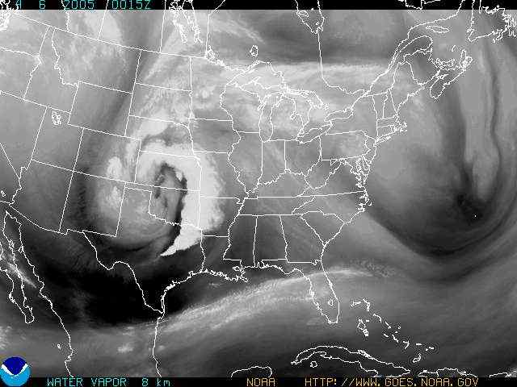
cP air mass
dry, cool air
High Pressure Area
mT air mass
warm, moist air
Low Pressure Center

