Slide 1
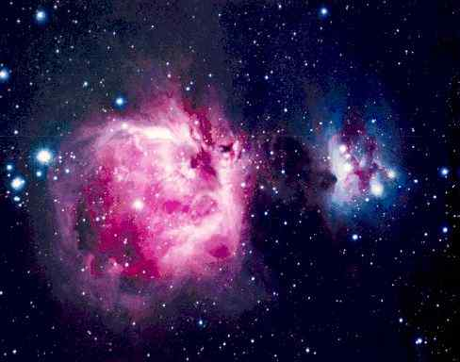
Astronomy Notes
Page 4
The Universe
©Mark Place, 2009-2010
www.LearnEarthScience.com

Slide 2
Big Bang Animation

Slide 3
What did the Big Bang sound like?
Forget the big bang, tune in to the big hum
THE big bang sounded more like a deep hum than a bang, according to an analysis of the radiation left over from the cataclysm. Physicist John Cramer of the University of Washington in Seattle has created audio files of the event which can be played on a PC. "The sound is rather like a large jet plane flying 100 feet above your house in the middle of the night," he says. Giant sound waves propagated through the blazing hot matter that filled the universe shortly after the big bang.
These squeezed and stretched matter, heating the compressed regions and cooling the rarefied ones. Even though the universe has been expanding and cooling ever since, the sound waves have left their imprint as temperature variations on the afterglow of the big bang fireball, the so-called cosmic microwave background. Cramer was prompted to recreate the din- last heard13.7 billion years ago- by an11-year-old boy who wanted to know what the big bang sounded like for a school project.
To produce the sound, Cramer took data from NASA's Wilkinson Microwave Anisotropy Probe. Launched in 2001, the probe has been measuring tiny differences in the temperature between different parts of the sky. From these variations, he could calculate the frequencies of the sound waves propagating through the universe during its first 760,000 years, when it was just 18 million light years across. At that time the sound waves were too low in frequency to be audible. To hear them, Cramer had to scale the frequencies 100,000 billion billion times.
Nevertheless, the loudness and pitch of the sound waves reflect what happened in the early universe. During the 100-second recording (http://www.npl.washington.edu/AV/BigBangSound_2.wav), the frequencies fall because the sound waves get stretched as the universe expands. "It becomes more of a bass instrument," says Cramer.
###
Author: Marcus Chown

Slide 4
What is the Big Bang Theory?
The universe started as a single point.
That point was extremely dense.
It became unstable and exploded outward.
Today the universe continues to expand.

Slide 5
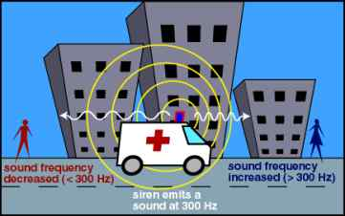
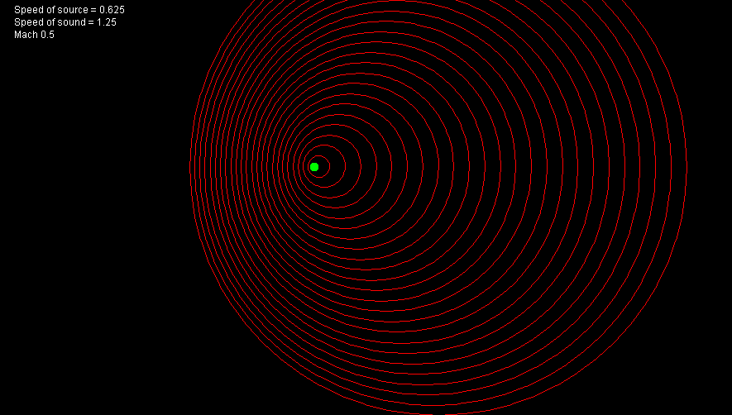
The Doppler Effect

Slide 6
Evidence for the Big Bang
light from distance
galaxies all shift toward red

Slide 7
Shifts in the Electromagnetic Spectrum
Red Shift = away
Blue Shift = toward

Slide 8
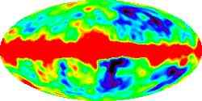
Evidence for the Big Bang
Cosmic Background Radiation

Slide 9
Put these in order of size:
galaxy solar system universe
universe
galaxy
solar system
Largest
Smallest

