Slide 1
Sun's Energy &
Climate Change
climate notes
page 3
©Mark Place, 2009-2010
www.LearnEarthScience.com

Slide 2
Sun's Energy & Climate
According to the graph below,
what wavelength
of energy does the Earth
receive in the greatest intensity?
visible light

Slide 3
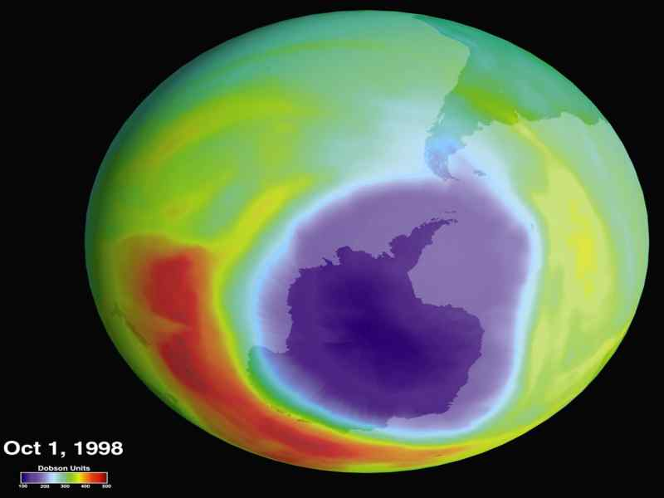
Sun's Energy & Climate
Name the primary gas
which absorbs ultraviolet (UV)
from the sun.
ozone

Slide 4
Sun's Energy & Climate
Name the three primary gases
which absorb infrared (IR) energy
methane
water vapor

Slide 5
Sun's Energy & Climate
Why is the ozone
layer important?
It protects the Earth from UV which damages crops and
causes cancer in humans.

Slide 6
Sun's Energy & Climate
Why is it warmer on a
cloudy night than
on a clear night?
Clouds (H₂O vapor) absorb IR energy radiated by the Earth. On a clear night, the IR energy escapes back into space.

Slide 7
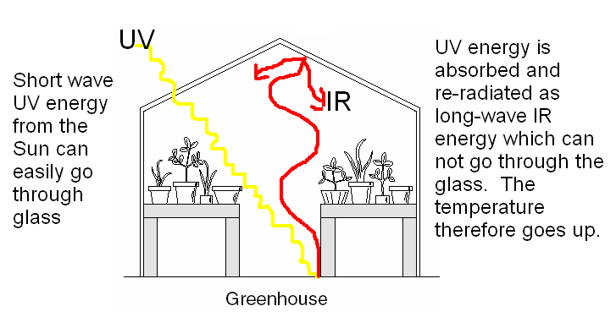
Explain the greenhouse effect.
Include a diagram which shows the
change in wavelength.
Apply It

Slide 8
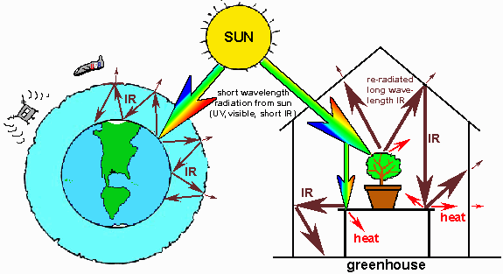
Just like a greenhouse, the gases in
the atmosphere ---especially CO₂ ---
absorb re-radiated infrared energy.

Slide 9
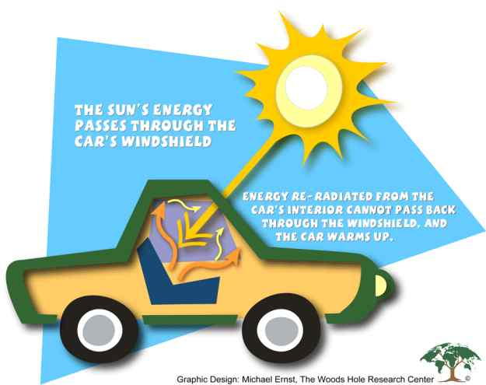

Slide 10
Climate Change

Slide 11
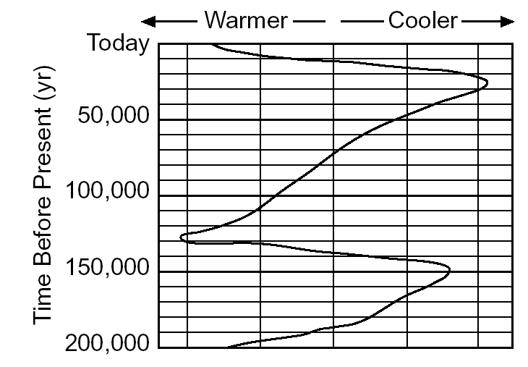
Ice Ages

Slide 12
Ice Ages
Ice Ages are cyclic.
The last one occurred
~12,000 years ago
The exact cause of
what triggers an ice age
is not known

Slide 13
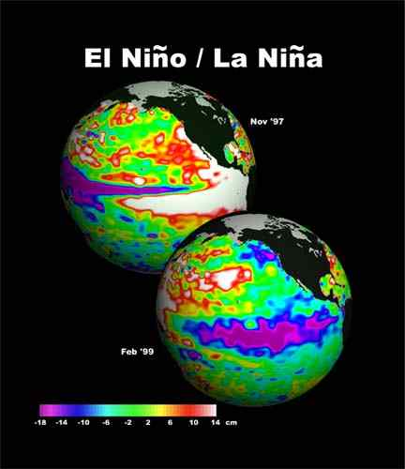

Slide 14
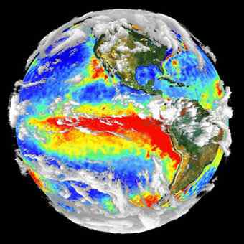
El Niño
A warming of the
Pacific Ocean.
Winters:
West = Stormy
South = Cold, wet
Northeast = warmer

Slide 15
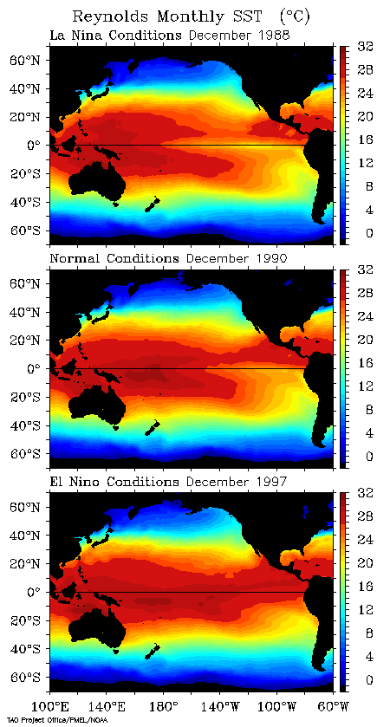

Slide 16
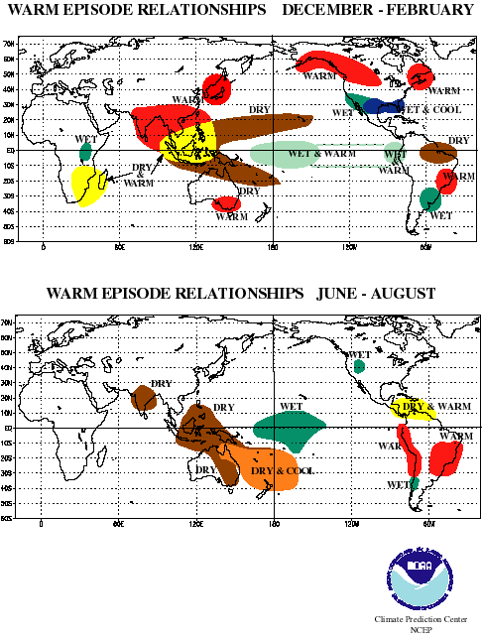

Slide 17
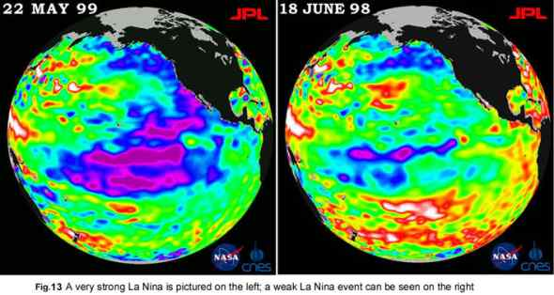
La Niña
A cooling of the Pacific Ocean.
Dry in southeast. Cool, wet in northwest.

Slide 18
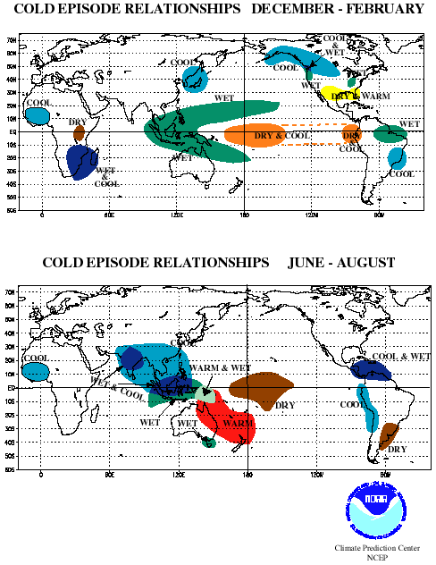

Slide 19
Global Warming
Average global temperatures
are increasing.
Glaciers are melting.
Ocean levels are rising.
Warming is natural.
Humans are speeding up the process
through increased levels of
carbon dioxide (CO₂)

Slide 20
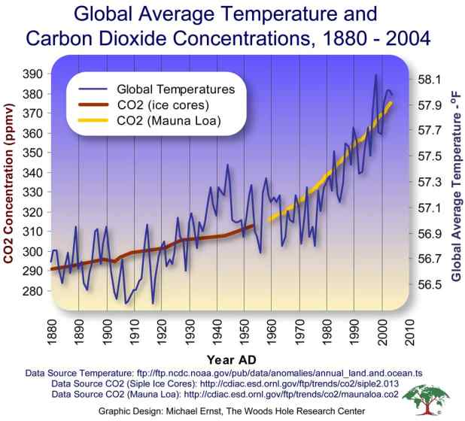

Slide 21
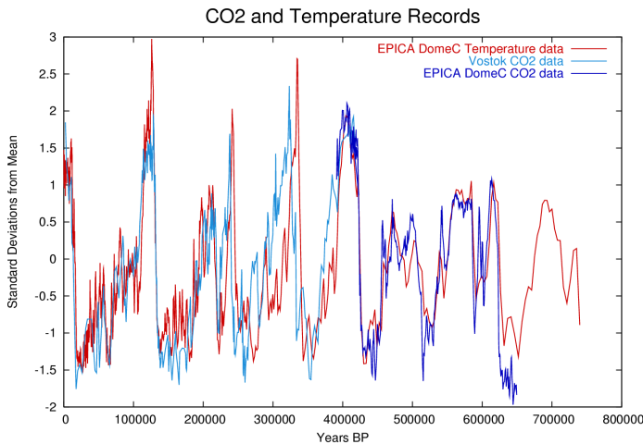

Slide 22
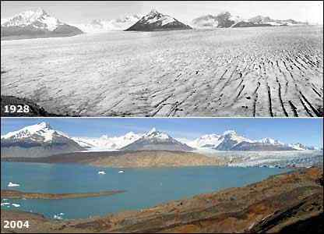

Slide 23
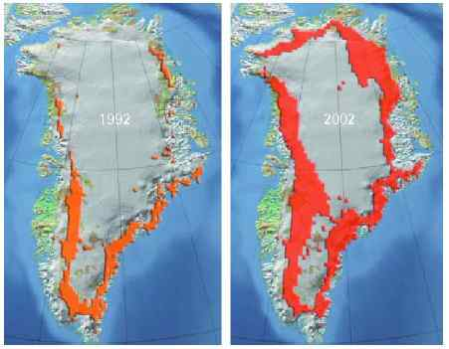

Slide 24
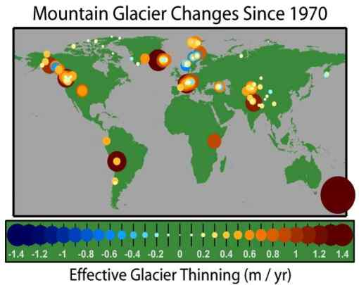
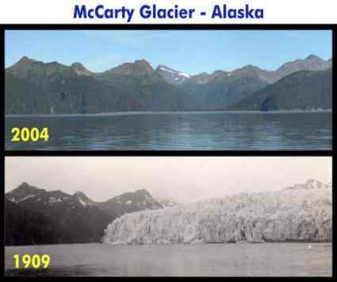
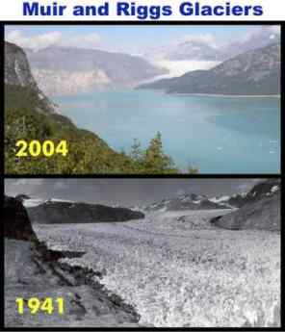
Mountain Glaciers

Slide 25
