Slide 1
Deposition
Hydrology NOTES
page 11
©Mark Place, 2009-2010
www.LearnEarthScience.com

Slide 2
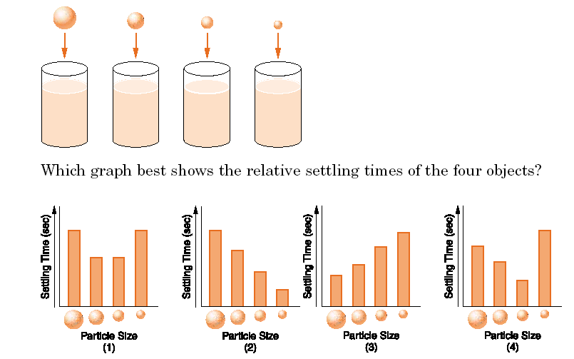
big objects take the
least amount of time to settle

Slide 3
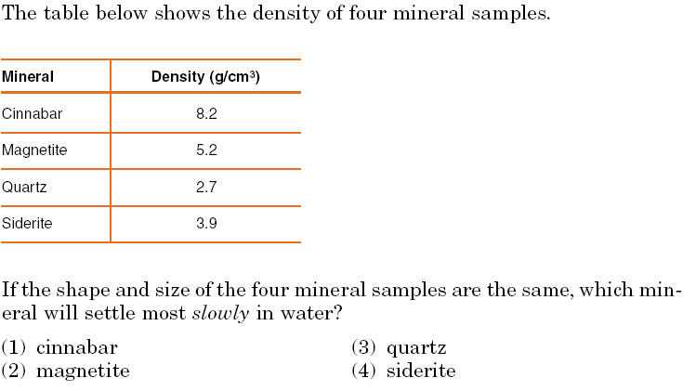
denser particles settle first

Slide 4
Rate of Settling
Particle Shape

Slide 5
Rate of Deposition
Slope

Slide 6
Rate of Deposition
Stream Velocity

Slide 7
Rate of Deposition
Stream Discharge

Slide 8
Deposition in Rivers

Slide 9
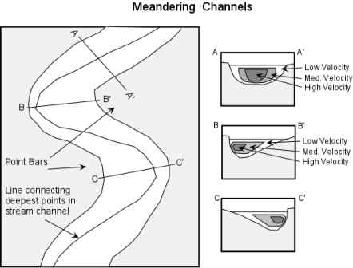
Where is
deposition
greatest?
Inside of Curve
Mouth of River

Slide 10
Why?
lowest velocity

Slide 11
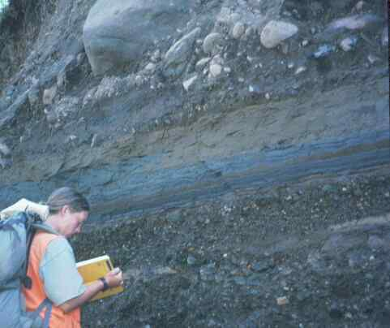
What
agent
of deposition?
glacier

Slide 12
Deposition by Streams: Graded Bedding
slow
fast
slow
fast

Slide 14
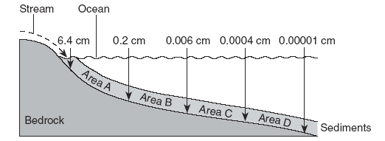
What happens to particle size?
Why?

Slide 15
What happens to particle size?
decreases, because the velocity decreases

Slide 16
delta
What is this?

Slide 17
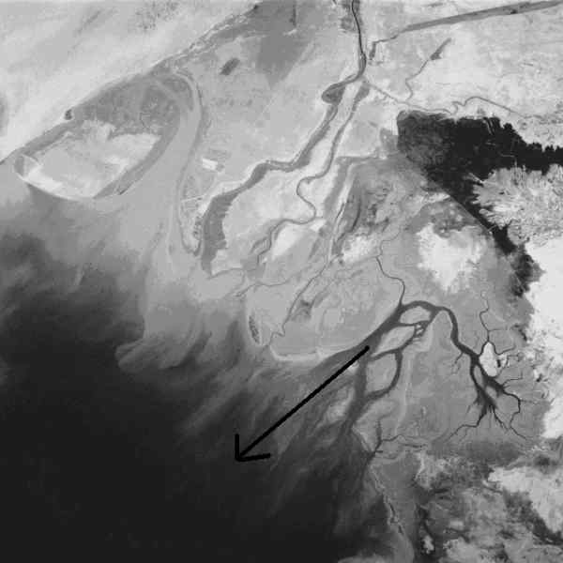
large
small

Slide 18
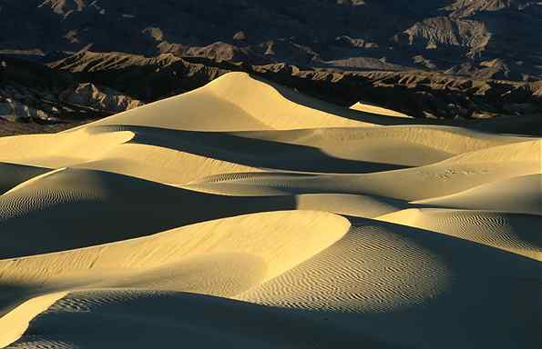
What agent?
wind

Slide 19
What direction?

Slide 20
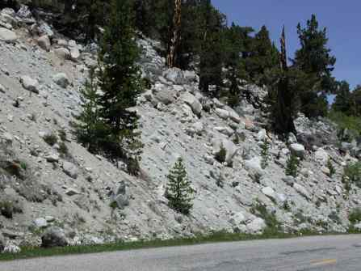
Glacial Deposits
till
unsorted

Slide 21
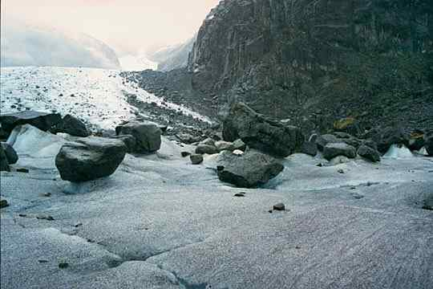
Glacial Deposits
erratics

Slide 22
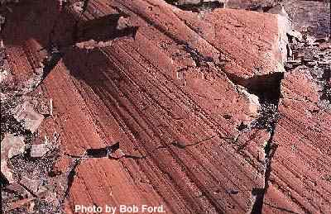
Glacial Deposits
striations

Slide 23
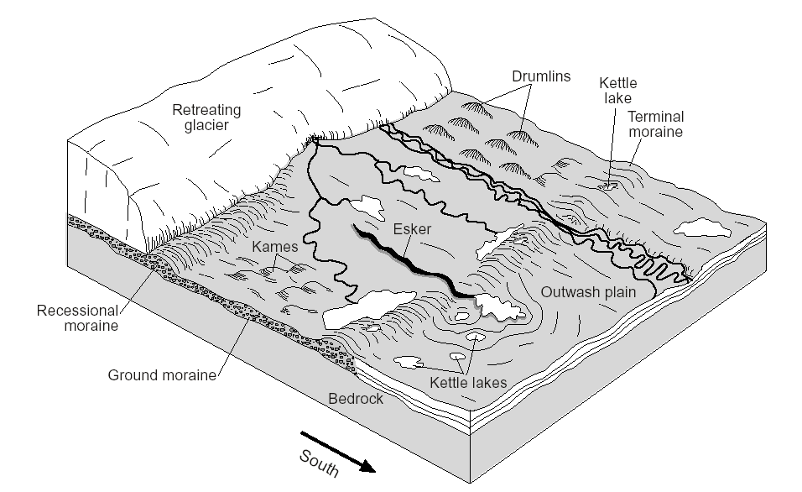
Glacial Features

