Slide 1
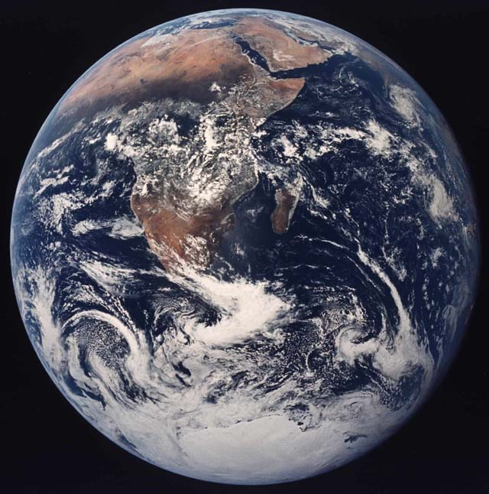
Earth Motions
Astronomy
Page 8
©Mark Place, 2009-2010
www.LearnEarthScience.com

Slide 2
Earth's Motions
How long is one rotation of Earth?
One day
How long is one revolution of Earth?
One year

Slide 3
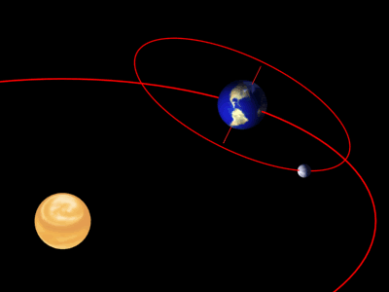
Rising and Setting
of the Sun
Rotation
Rising and Setting
of the Moon
Movement of Stars
through the sky
The Seasons
Changing
Constellations
Revolution

Slide 4
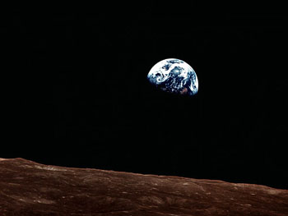
How do you calculate
Earth's rate of rotation?
One rotation = 360°
Time for one rotation = 24 hours
360° ÷ 24 = 15°/hr

Slide 5
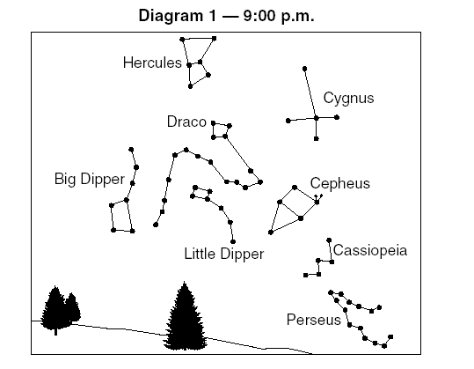
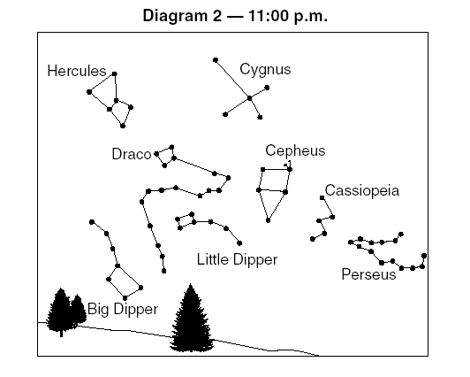
How many degrees did the stars move
from diagram 1 to
diagram 2?
30° (2 hours x 15°)

Slide 6
It’s the only one that didn’t move
How can you find
Polaris?

Slide 7
Northern
Because Polaris can only been seen in the North
What hemisphere
must you be in?
Why?

Slide 8
What direction must
you be looking?
North

Slide 9
What direction do
the stars appear to
move?

Slide 10
What causes the
stars appear to move?

Slide 11
Evidence for Rotation
Foucault Pendulum
Coriolis Effect

Slide 12
Evidence for Revolution
Changing Constellations
Parallax

