Slide 1
Earth Quakes
Tectonics NOTES
page 3
©Mark Place, 2009-2010
www.LearnEarthScience.com

Slide 2
Key Concepts & Questions
What is the driving force
behind crustal movement ?

Slide 3
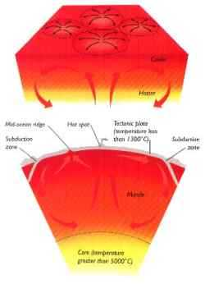
Key Concepts & Questions
Convection
Currents
in the
Mantle

Slide 4
On to the next question:

Slide 5
Key Concepts & Questions
What provides the energy for this force?
radioactive decay

Slide 6
On to the next question:

Slide 7
Key Concepts & Questions
What are the different types
of earthquake waves? And
how do they travel?

Slide 8
Key Concepts & Questions
p-waves
Travel
Through
Anything
primary waves
push-pull waves

Slide 9
Key Concepts & Questions
s-waves
Travels
Through
Solids Only
secondary waves
shear waves

Slide 10
On to the next question:

Slide 11
Key Concepts & Questions
Where can most earthquake
epicenters and volcanoes be
found?

Slide 12
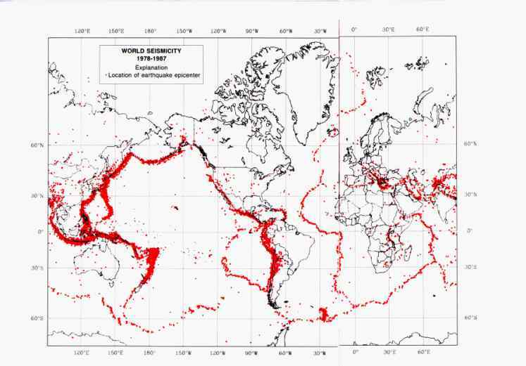
How does this compare
with page 5 of the ESRTs?

Slide 13
Key Concepts & Questions
at plate boundaries

Slide 14
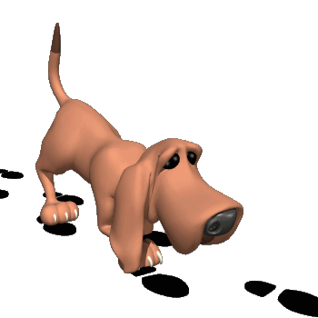
On to the next question:

Slide 15
Key Concepts & Questions
To find an earthquake’s
epicenter a seismologist
must have data from at
least how many locations?

Slide 16
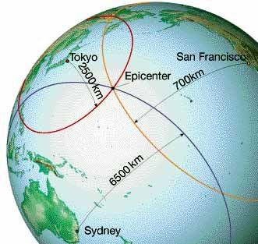
At least three

Slide 17
On to the next question:

Slide 18
Key Concepts & Questions
How can scientists
infer the properties
of Earth’s interior?

Slide 19
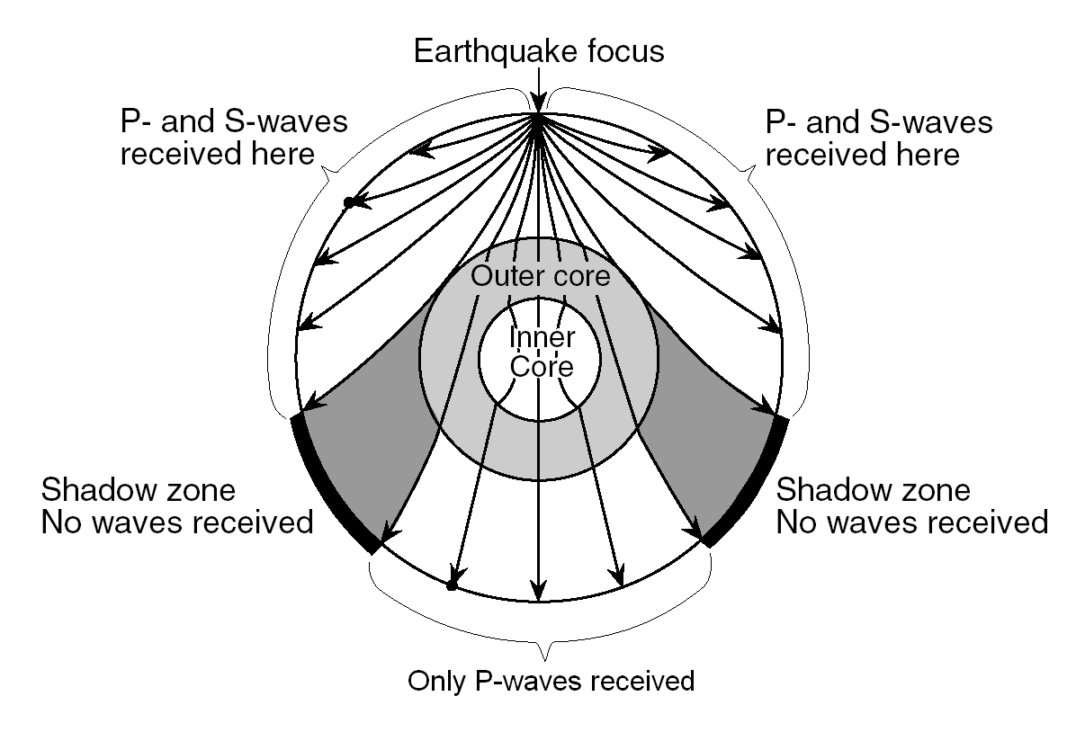
by observing
earthquake waves

Slide 20
On to the next question:

Slide 21
Key Concepts & Questions
How do scientists know that
Earth’s inner core is solid?

Slide 22
by the refraction
of P-waves

Slide 23
On to the next question:

Slide 24
Key Concepts & Questions
What can people do
to protect themselves
during an earthquake?

Slide 25
get under desk/table
stand against interior wall
stay away from windows

Slide 26
On to the next question:

Slide 27
Key Concepts & Questions
What is the
Richter Scale and
how is it used?

Slide 28
a measure of earthquake strength
used to describe
expected damage

Slide 29
Earth Quake Reference Table Questions

Slide 30
If a p-wave arrives five minutes
before the s-wave arrives, how
many kilometers from the
epicenter is a location?
3600 kms

Slide 31
If a p-wave arrives at 12:10:00 and
the s-wave arrives at 12:16:20, how
many kilometers from the
epicenter is a location?
4800 kms

Slide 32
An earthquake epicenter is 2600
kilometers from a location.
If the p-wave arrives at 9:00:20,
what time will the s-wave arrive?
9:04:20

Slide 33
An earthquake epicenter is 5200
kilometers from a location. If the s-
wave arrives at 1:20:20, what time
did the p-wave arrive?
1:13:20

Slide 34
If a p-wave arrives 6 mins after an
earthquake occurs, how many
kilometers is the location from the
epicenter? How long after the p-
wave arrives will the s-wave
arrive?
3200 kms
4:40 later

Slide 35
