Slide 1
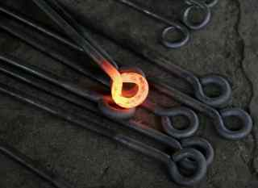
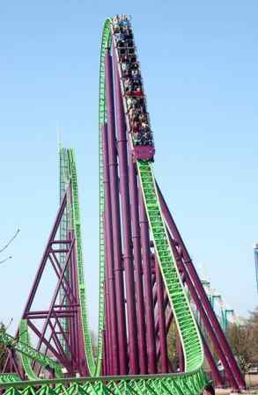
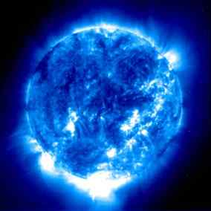
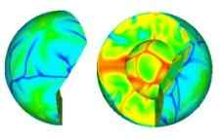
Energy Notes
Page 3
©Mark Place, 2009-2010
www.LearnEarthScience.com

Slide 2
Energy Transfer
What’s the difference between
kinetic and potential energy?
Give a real-life example of each.

Slide 4
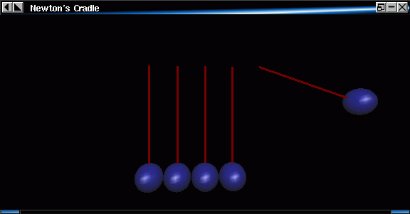

Slide 5
Kinetic Energy
energy in motion
EXAMPLES
SKIING DOWNHILL
THROWING A BOWLING BALL
WATER FLOWING IN A RIVER

Slide 6
Potential Energy
stored energy
EXAMPLES
AT THE TOP OF A SKI SLOPE
WATER BEHIND A DAM

Slide 7
What are the three ways that
energy can be transferred
between objects?
Give one real-life example
of each.

Slide 8
conduction
solids
occurs in _____________
________________of molecules
collision
Example:

Slide 9
convection
liquids & gases
occurs in _____________________
caused by ____________________
differences in density

Slide 10
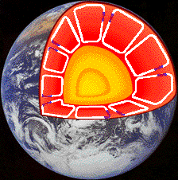
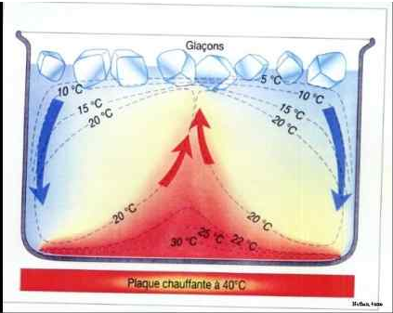
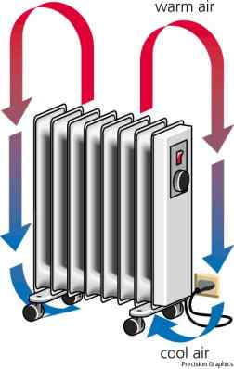
convection examples:

Slide 11
convection
From where do convection
ovens heat?
From the top or the bottom?
From where do
refrigerators cool?
From the top or the bottom?

Slide 12
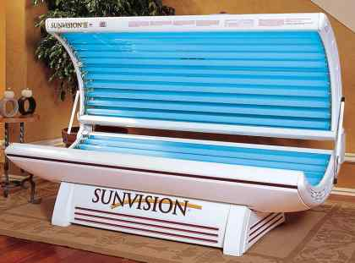
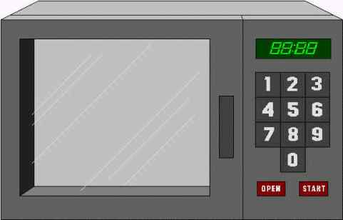
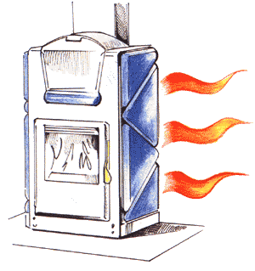
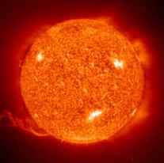
radiation
waves
travel by _____________
Examples:

Slide 13
How are different types of
energy told apart?
by their wavelengths
Which is more powerful?
Short or long waves?
short

Slide 14
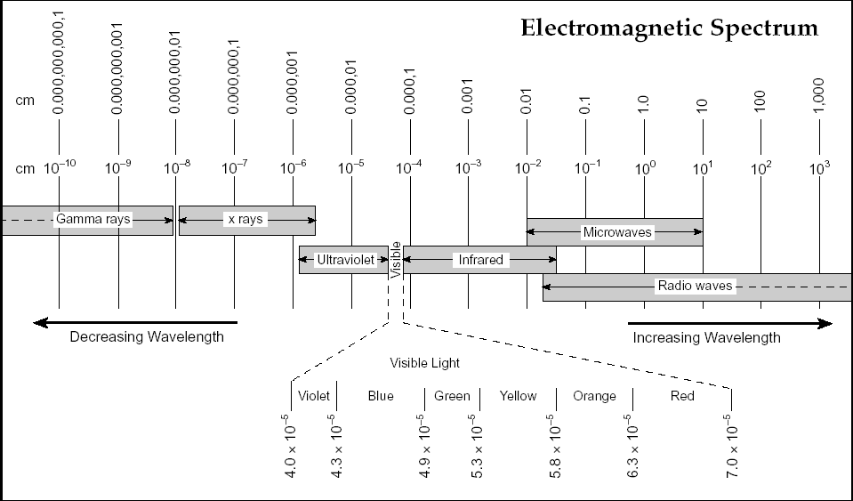

Slide 15
How does energy get from
the Sun to the Earth?
radiation

Slide 16
Best Absorbers
dark & rough
Best Reflectors
light colored & smooth

Slide 17
A good absorber
is a good
RADIATOR

