Slide 1
Please turn to
Page 4
in your
Energy NOTES
©Mark Place, 2009-2010
www.LearnEarthScience.com

Slide 2
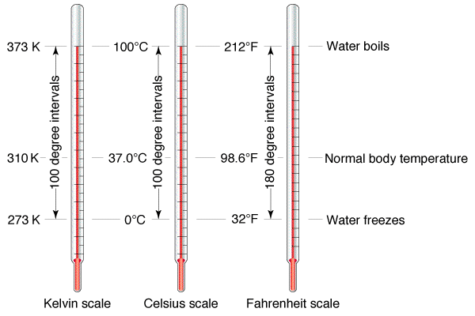

Slide 3
Temperature Conversion
Fill in the chart below using your Earth Science Reference Tables.
Fahrenheit (°F) | Celsius (°C) | Kelvin (K)
30
 | 30
 |  | 330
-1
272
86
303
135
57

Slide 4
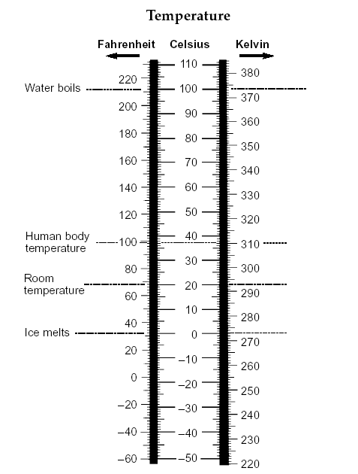

Slide 5
Temperature Conversion
Describe the word TEMPERATURE
in relation to molecular motion.
Cold
Hot

Slide 6
Temperature Conversion
What happens to molecular motion
at absolute zero? What temperature
is this in all temperature scales?
At absolute zero, all motion stops.
0K
-273°C
-459°F

Slide 7
Specific Heat
the amount of energy required
to raise the temperature of
1 gram of a substance 1°C
Please go to Page 1 of the
Earth Science Reference Tables.

Slide 8
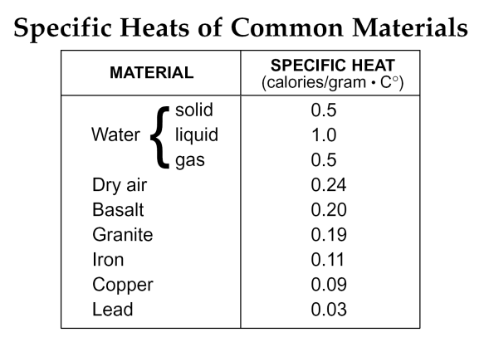

Slide 9
Specific Heat
Why does water heat up and cool
down slower than land?
it has a higher specific heat

Slide 10
Specific Heat
If you heated equal masses of
basalt and lead, which one would
record a faster increase in
temperature? Explain how you know.
the lead
because it has a lower specific heat

Slide 11
Specific Heat
Which Earth material has the
greatest specific heat?
liquid water

Slide 12
Heating Curve for Water
Draw the graph of water heating. Label the following terms in their correct places: condensation, vaporization, solidification, melting.
Heat lost
vaporization
(+540 Cal)
gas
100
condensation
( -540 Cal)
melting
(+80 Cal)
liquid
Temperature (ºC)
0
solidification
(-80 Cal)
solid
Heat added

Slide 13
Check the box which describes whether energy
is gained or lost for each process.
Process | Energy Gained | Energy Lost
Condensation
Evaporation
Melting
Solidification
How many calories are gained or lost by water
for each of the following processes?
Process | Calories Gained | Calories Lost
Condensation
Evaporation
Melting
Solidification
540
540
80
80

Slide 14
