Slide 1
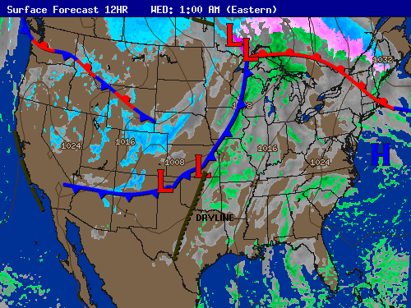
Fronts
©Mark Place, 2009-2010
www.LearnEarthScience.com

Slide 2
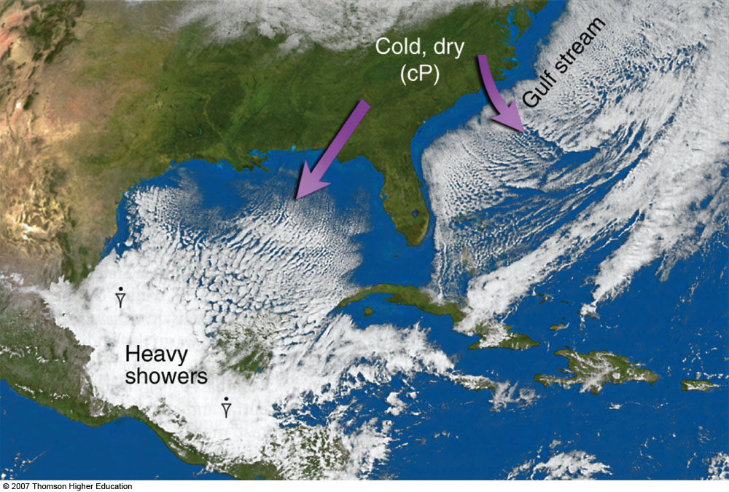
FRONTS
Please Go To
Page 14
a boundary (interface)
between air masses

Slide 3
The Rule:
triangles and bumps
always point in the
direction the front
is moving

Slide 4
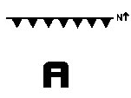
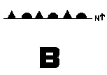
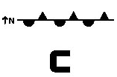
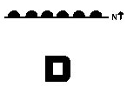
a cold front moving south
an occluded front
a stationary front with cold air on the south side
a warm front moving north
a stationary front with warm air on the south side

Slide 5
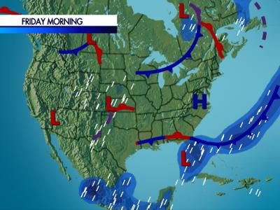

Slide 6
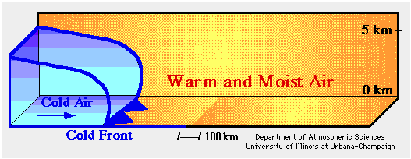
Cold Fronts
Animation #1
Images

Slide 7
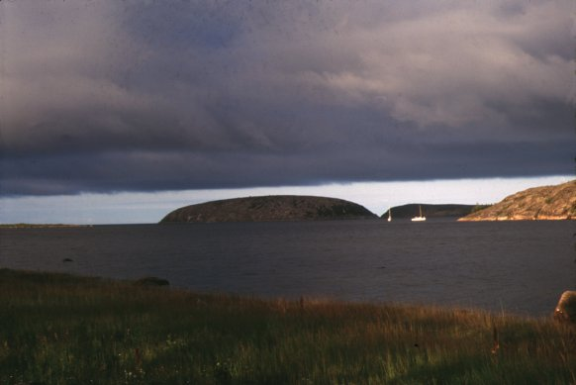

Slide 8
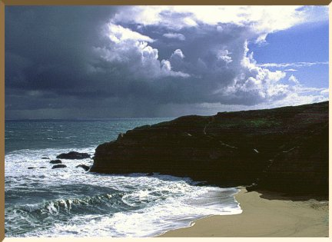

Slide 9
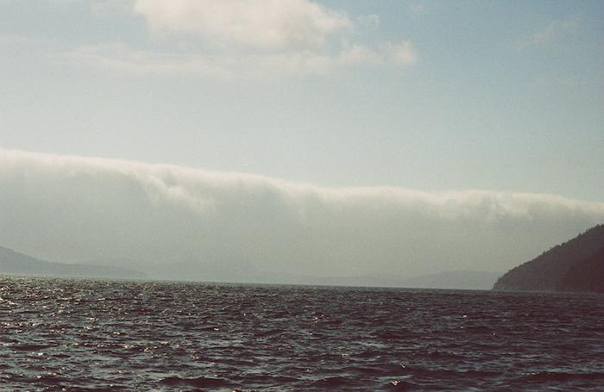

Slide 10
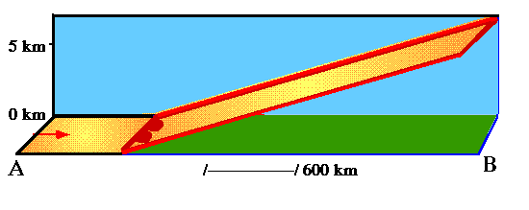
Warm Fronts
Animation #1
Images

Slide 11
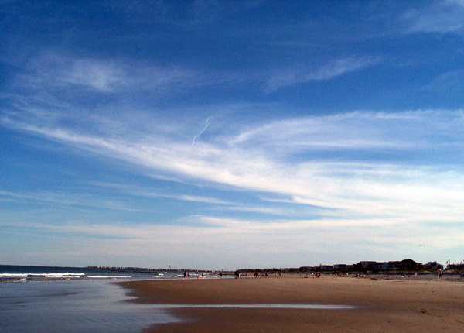

Slide 12
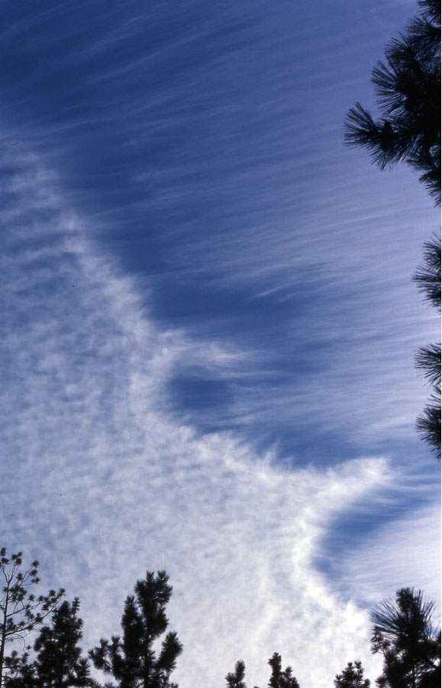

Slide 13
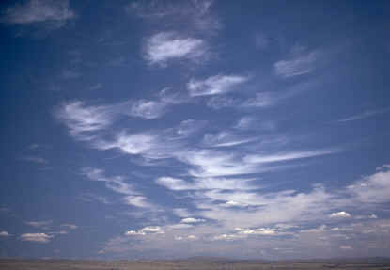

Slide 14
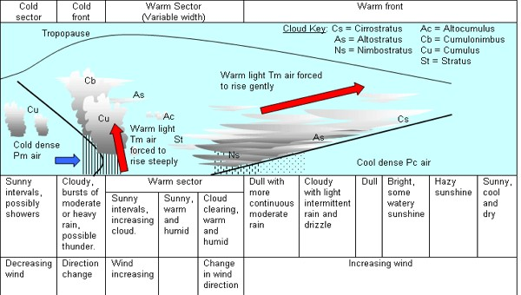
PAGE 12

Slide 15
PAGE 13
COLD FRONTS:
Using the Words below, complete the paragraph.
15 degrees, cold, cold, colder, colder, cooler, clouds, drier, hail, rain, thunderstroms, tornadoes, towering clouds form, warm, warmer
Passage of a cold front:
Cold fronts occur when a .............. air mass replaces a ................ air mass.
In a cold front the .............. air follows the warm air, and, because .................. air is denser, pushes ................ air out of its way, forcing the warm air to rise.
The lifting warm air mass becomes ................, and ................. start to form.
Precipitation at cold fronts are usually heavier although less extensive (50-70 km) and less prolonged.
The reason for this is that the uplift of warm air there is stronger due to the undercutting of cold air, so......................................., and .........., ......................................, ................ and ............................ can occur.
The air behind a cold front is noticeably .......................... and ................... than the air ahead of it.
When the cold front passes through, temperatures can drop more than ........................... within the first hour.

Slide 16
PAGE 13
WARM FRONTS:
Using the Words below, complete the paragraph
air, cirrus clouds, cold, colder air mass, in front of them, lifts up, move slowly, settling over the cold front, warm, warmer, warmer and more humid
Warm fronts:
Warm fronts occur, when a ......................air mass approaches a ............................... The warmer air ....................... and over the colder air.
.................fronts are usually more gentle than ..............fronts, ................................, gently ..................................................and moving it out of the way.
Precipitation at warm fronts are usually less heavy although more extensive (300-400 km), than at the cold fronts. The .................behind a warm front is warmer and more moist than the air ahead of it.
Warm fronts bring more steady, lighter rain or snow ………………………, which can last from a few hours to several days. When a warm front passes through, the air becomes noticeably ...................................than it was before.
The first signs of the warm front are the ..........................., followed by the cirrostratus, altostratus, nimbocumulus and stratocumulus types of clouds.

Slide 17
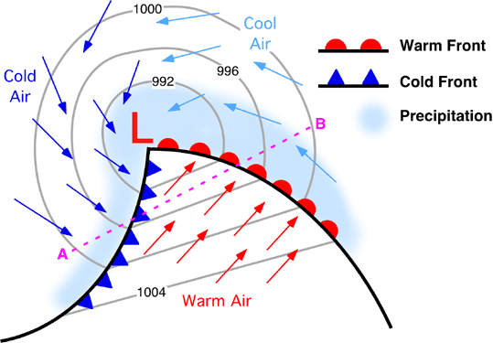
PAGE 12
Animation

