Slide 1
HYDROLOGY
Notes
Page 3
©Mark Place, 2009-2010
www.LearnEarthScience.com

Slide 2
The water cycle
is also called the
cycle.
hydrological

Slide 3
Water that is stored
in the oceans and
lakes can
and become a gas.
evaporate

Slide 4
As the water
rises through the
atmosphere, it cools,
condenses and becomes
clouds

Slide 5
When the water gets heavy enough it can fall to the ground in the form of different types of
precipitation

Slide 6
If the lithosphere (ground) is saturated, the water that has fallen can become
and flow directly into streams, rivers, or lakes.
runoff

Slide 7
If the lithosphere is not saturated, the water will
the lithosphere and move into the zone of
or the zone of
infiltrate
aeration
saturation

Slide 8
The interface (boundary) between these two zones is called the
water table

Slide 9
The roots of plants can reach into the zone of
soak up the water, and the water can then re-enter the atmosphere through the process of
saturation
transpiration

Slide 10
Water Cycle Song

Slide 11
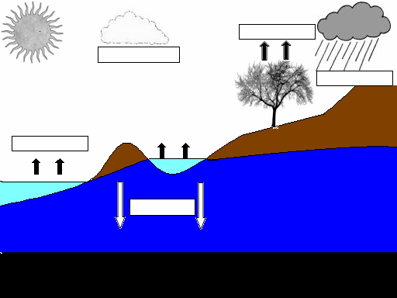
transpiration
condensation
precipitation
runoff
evaporation
zone of aeration
runoff
evaporation
water table
infiltration
zone of saturation
impermeable bedrock

Slide 12
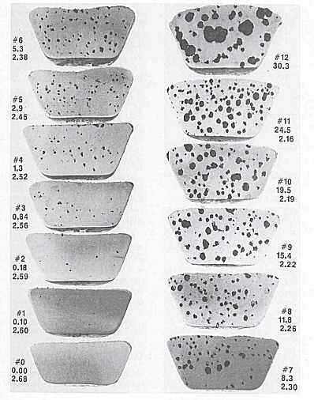
Porosity

Slide 13
Porosity =
Total volume of empty space
÷ total volume of soil
What materials would you need to calculate the porosity of a sample of soil?
graduated cylinder
water

Slide 14
***Particle size alone does not determine porosity***
Particle Size
Porosity

Slide 15
Which is more porous, a container of:
round particles or angular particles
tightly packed particles or loosely packed particles
c. well-sorted particles or unsorted particles
d. large beads or small beads

Slide 16
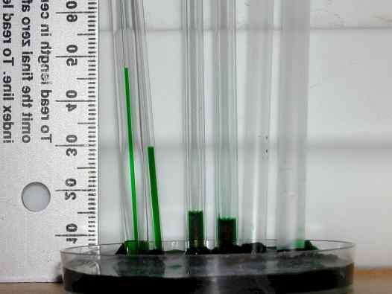
Capillarity

Slide 17
PERMEABILITY

Slide 18
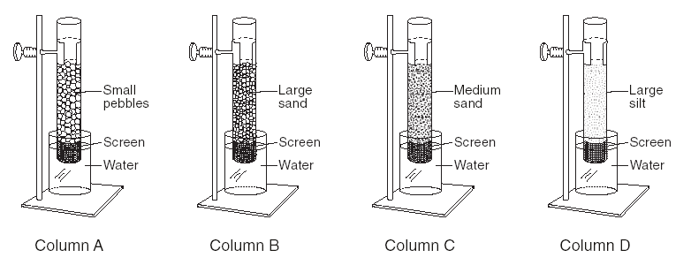
PERMEABILITY
Which column would allow water
to flow through fastest? Why?
A, because the particles are largest

Slide 19
PERMEABILITY
Particle Size

Slide 20
PERMEABILITY
If you join sediment from A and D,
what would happen to the permeability? Why?
Decreases because the small particles fill in the spaces

Slide 21
PERMEABILITY
Which is more permeable?
a. small particles or large particles
b. frozen ground or unfrozen ground

Slide 22
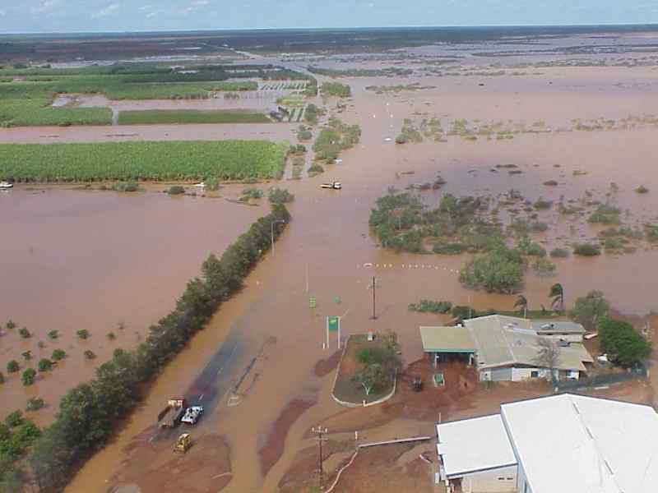
FACTORS AFFECTING
RUNOFF AND STREAM DISCHARGE
Which will result in greater runoff and stream discharge?
an area that is vegetated or an area that is barren
an area that has a steep slope or an area that is flat
ground that is frozen or ground that is unfrozen
d. ground that is saturated or ground that unsaturated

