Slide 1
Igneous Rocks Rocks & Minerals Notes: Page 7
©Mark Place, 2009-2010
www.LearnEarthScience.com

Slide 2
Igneous Rocks
Key Concept #1
How are igneous rocks formed?
Please go to the
"Rock Cycle" on
Page 6 of the
ESRTS
the melting and
solidification of
magma

Slide 3
Igneous Rocks: Key Concept #2
Name two places where igneous rocks form

Slide 4
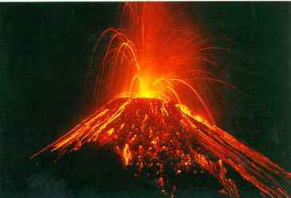
Volcanoes
Rifts/Ridges

Slide 5
Igneous Rocks: Key Concept #3
What determines crystal size?

Slide 6
cooling time

Slide 7
crystal size
cooling time

Slide 8
Large Crystals Indicate
long cooling time
Small Crystals Indicate
short cooling time

Slide 9
Igneous Rocks: Key Concept #4
What’s the difference between
extrusive and intrusive igneous rocks?

Slide 10
Extrusive
Intrusive
form on or near the
surface
(small crystals)
form below the
surface
(large crystals)

Slide 11
Igneous Rocks: Key Concept #5
Characteristics used to classify igneous rocks

Slide 12
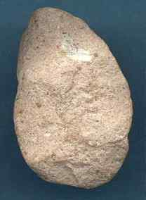
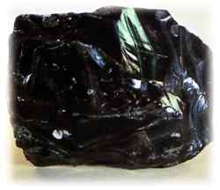
Key Concept #5
Characteristics used to classify igneous rocks
texture
glassy
}
extrusive
fine

Slide 13
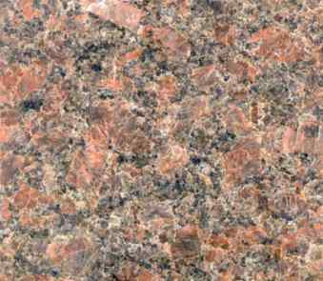
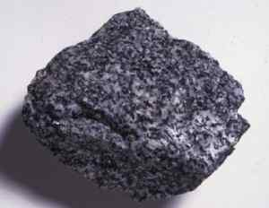
Key Concept #5
Characteristics used to classify igneous rocks
texture
coarse
}
intrusive
very coarse

Slide 14
Key Concept #5
Characteristics used to classify igneous rocks
color
light
dark

Slide 15
Key Concept #5
Characteristics used to classify igneous rocks
density
low
high

Slide 16
Key Concept #5
Characteristics used to classify igneous rocks
composition
mafic
contains Fe and Mg
felsic
contains Al

Slide 17
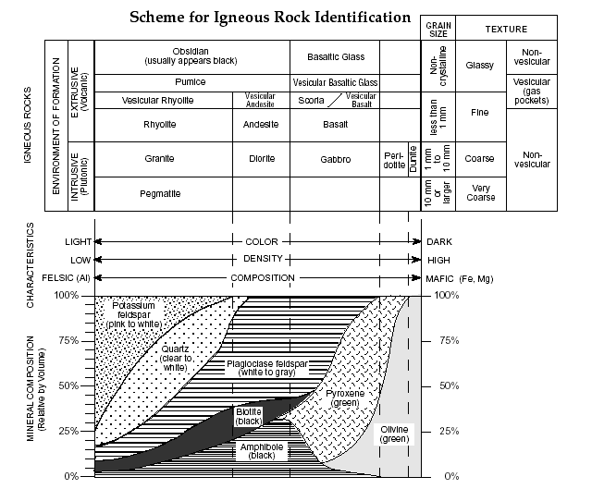

Slide 18
Igneous Rocks: Key Concept #6
Key Identifying Features of Igneous Rocks

Slide 19
Glassy Texture
usually black in color
Interlocked Grains
the grains have been melted
and are now physically connected

Slide 20
Please Answer the Questions on Page 8 Using Your Earth Science Reference Tables.

Slide 21
Answers on the Next Page

Slide 22
The Answers (Page 8): 1. Basaltic Glass 2. Granite 3. Basalt
Stop and complete
the Igneous
Rock Lab

Slide 23
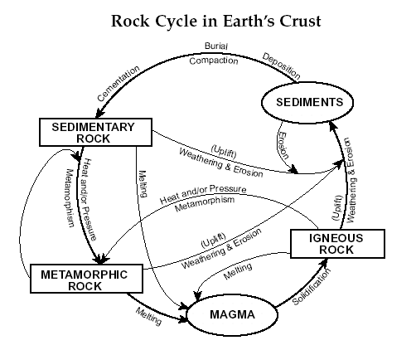
Earth Science
Reference Tables
Page 6

