Slide 1
Rocks & Minerals Notes: Pages 4 - 11
©Mark Place, 2009-2010
www.LearnEarthScience.com

Slide 2
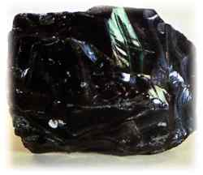
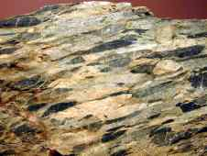
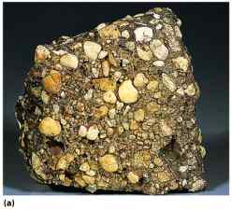
Rocks

Slide 3
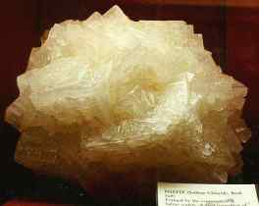
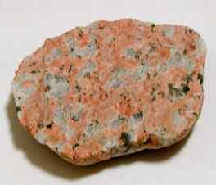
Poly-mineralic
Mono-mineralic
made of
two or more
minerals
made of
one mineral

Slide 4
Most Rocks Are
Poly-mineralic

Slide 5
Three Classifications
of Rocks are:
igneous
sedimentary
metamorphic

Slide 6
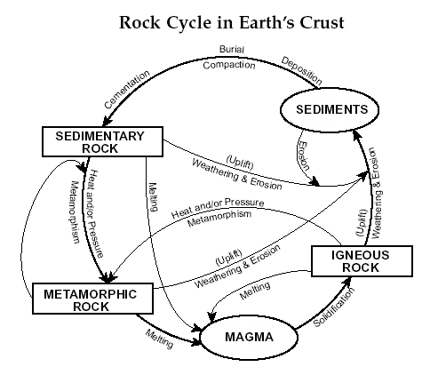
Earth Science
Reference Tables
Page 6

Slide 7
Sedimentary Rocks
Key Concept #1
Most sedimentary rocks are made of pieces
( clasts )
of other rocks.
Image #2
Image #1

Slide 8
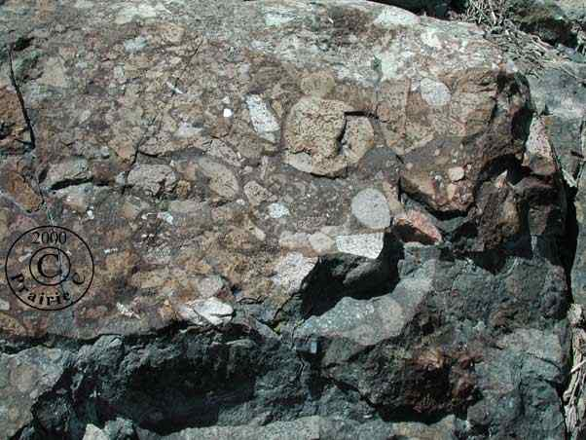

Slide 9
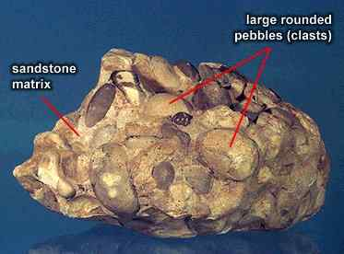

Slide 10
Key Concept #2
Name two processes that
form sedimentary rocks
Cementation
Compaction
clasts held
together by
minerals
(cement)
the weight of
overlying sediments
forces particles
together

Slide 11
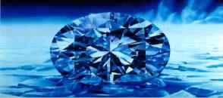
Key Concept #3
In what type of environment are most
sedimentary rocks formed?
watery

Slide 12
Key Concept #4
Key Identifying Features of
Sedimentary Rocks
Strata
Clear Layering of Sediments
Image #1
Image #2
Image #3

Slide 13
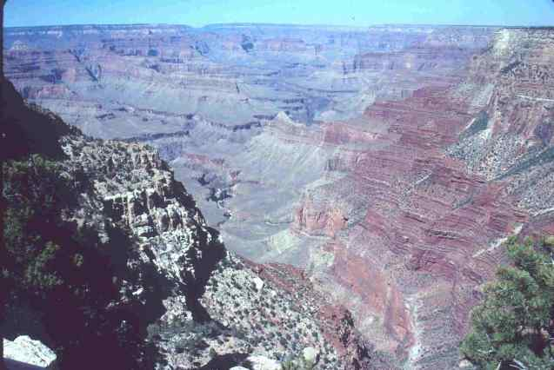

Slide 14
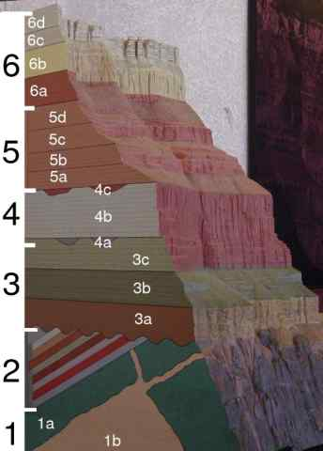

Slide 15
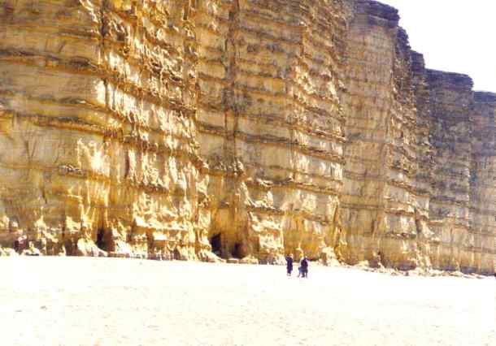

Slide 16
Key Concept #4
Key Identifying Features of
Sedimentary Rocks
Clasts
pieces of other rocks
Image #2
Image #1

Slide 17
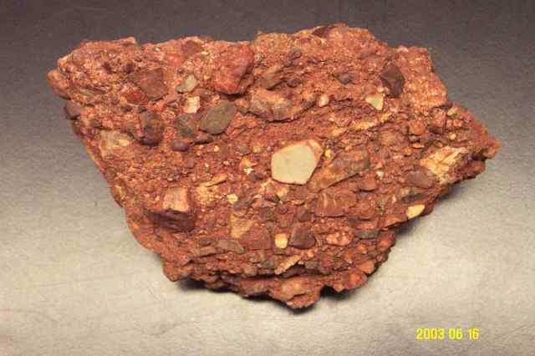

Slide 18
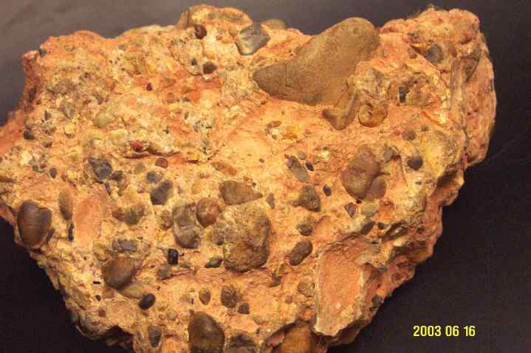

Slide 19
Key Concept #4
Key Identifying Features of
Sedimentary Rocks
Fossils
the remains of once-living organisms
Image #1
Image #3
Image #4
Image #2

Slide 20
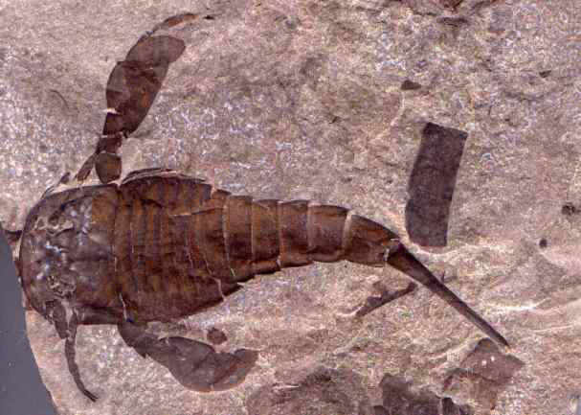

Slide 21
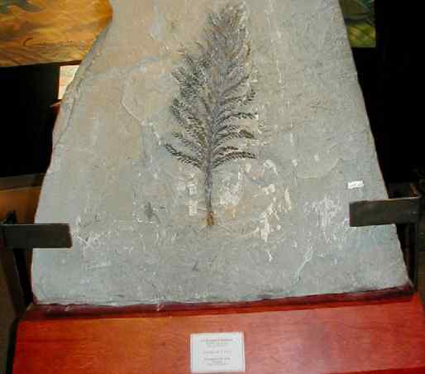

Slide 22
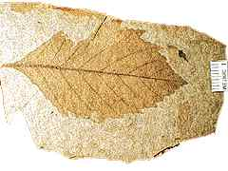
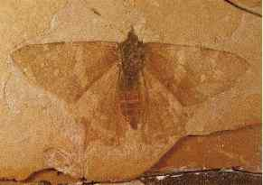
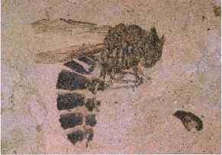

Slide 23
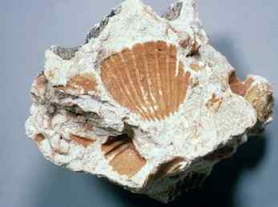
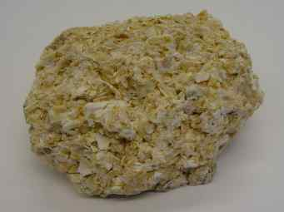

Slide 24
Please Answer the Questions on Page 5 Using Your Earth Science Reference Tables.

Slide 25
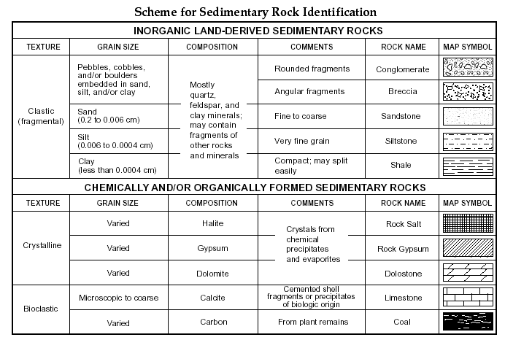
Answers on the Next Page

Slide 26
The Answers (Page 5): 1. Limestone 2. Breccia 3. Limestone 4. Coal 5. Rock Gypsum
Stop and complete
the Sedimentary
Rock Lab

