Slide 1
Introduction to Earth Science
©Mark Place, 2009-2010
www.LearnEarthScience.com

Slide 2
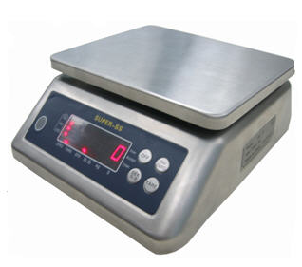
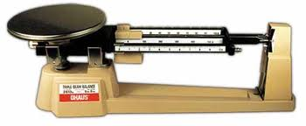
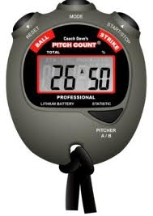
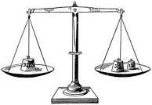
Scientific Instruments
 | Common Instrument
Volume of Regular, Rectangular Objects (a box)
Volume of Irregularly Shaped Objects (rocks)
Mass
Distance
Time
ruler
graduated cylinder
scale
ruler
stop watch

Slide 3
Formulas
density:
percent error (deviation):
rate of change:

Slide 4
Accuracy
What does it mean if you are asked to record your answer:
a. to the nearest tenth
one decimal place
Example: 0.1
b. to the nearest hundredth
two decimal places
Example: 0.01
to the nearest thousandth
three decimal places
Example: 0.001

Slide 5
Graphical Relationships
Direct Relationship:
increases
As one variable increases, the other __________________.
example
Photosynthesis
Bad Breath
Onions Eaten
Amount of Sunlight

Slide 6
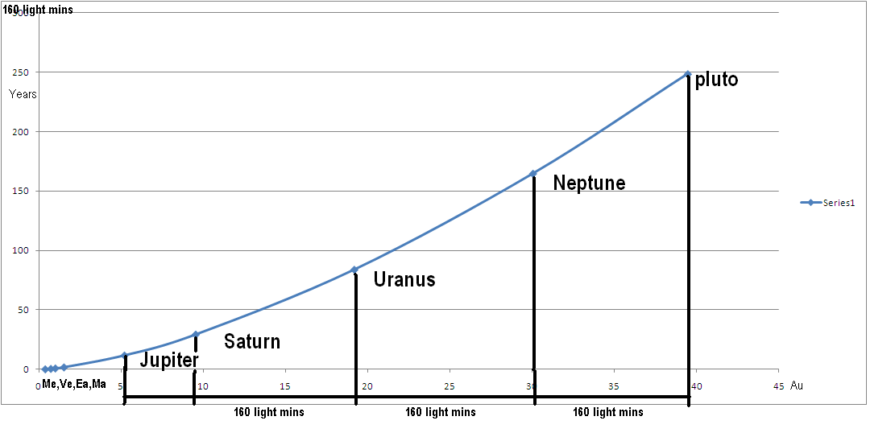
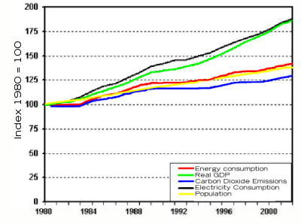
Graphical Relationships
Examples

Slide 7
Graphical Relationships
Indirect Relationship:
decreases
As one variable increases, the other __________________
example
People Sitting Near You
Beans Eaten

Slide 8
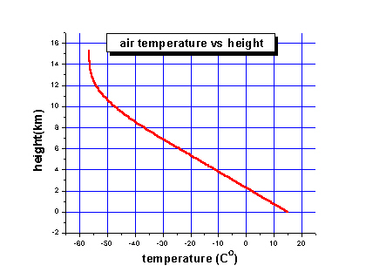
Graphical Relationships
Examples

Slide 9
Graphical Relationships
Cyclic Relationship:
As one variable increases, the other
changes in a predictable pattern
Events that are cyclic are also ___________________
predictable

Slide 10
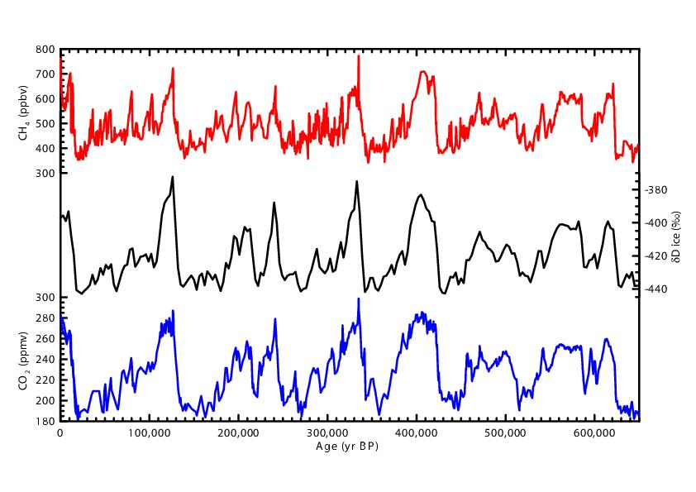
Graphical Relationships
Examples

Slide 11
Graphical Relationships
No Relationship:
stays the same
As one variable increases, the other __________________
Stunning Good Looks
My Age

Slide 12
Graphical Relationships
Examples

Slide 13
Graphical Relationships in Words
State in words the relationship between relief and the average rate of erosion as shown in the graph.
As relief increases, the average rate of erosion increases

Slide 14
Graphical Relationships in Words
State in words the relationship between air temperature and relative humidity.
As the air temperature increases, the relative humidity decreases

Slide 15
Introduction to Earth Science
Mark Place, 2009-2010
www.LearnEarthScience.com

Slide 16
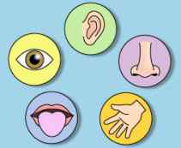
Observations, Inferences, Classification
What is used to make an observation?
SEE
HEAR
the five senses
SMELL
TASTE
TOUCH

Slide 17
Ready for some observation practice?

Slide 18
After observations have
been collected.
What does it mean to
make an inference?
make an educated guess
(an hypothesis)

Slide 19
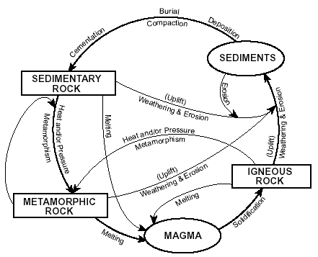
Give examples of how scientists
use classification systems.
Types of Rocks

Slide 20
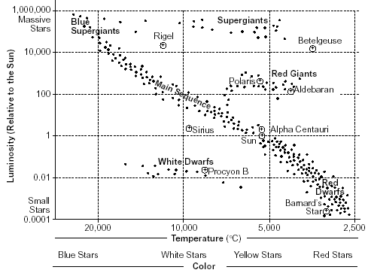
Give examples of how scientists
use classification systems.
Types of Stars

Slide 21
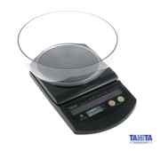
Name the common scientific
instrument used to measure mass:
DENSITY
MASS
VOLUME
Page 6
scale
If an object is heated, what happens
to its mass? Why?
NOTHING!
THE NUMBER OF
ATOMS REMAINS
THE SAME

Slide 22
If an object has a mass of 240g on Earth, its mass on the moon will be (more, less, the same).
Why?
DENSITY
MASS
VOLUME
Page 6
the same
THE NUMBER OF
ATOMS REMAINS
THE SAME

Slide 23
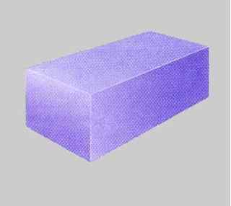
Volume of a regular rectangular object:
What instrument would be used to measure this object’s volume?
ruler

Slide 24
What is the formula for finding the volume of this object?
H
L
W
V = L x W x H

Slide 25
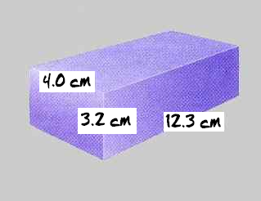
Calculate the volume of this object to the nearest tenth of a cM³. Show all formulas.
V = L x W x H
= 4.0 x 3.2 x 12.3
= 157.4 cm³

Slide 26
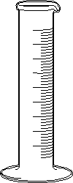
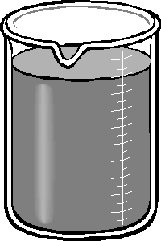
VOLUME of an irregularly
shaped object:
What instrument would be used to measure the volume of an object such as a rock?
graduated cylinder

Slide 27
VOLUME of an irregularly
shaped object:
Describe the process you would use.
Put water into cylinder.
Measure volume of water.
Place object in cylinder.
Re-measure volume of water.
Subtract volumes.

Slide 28
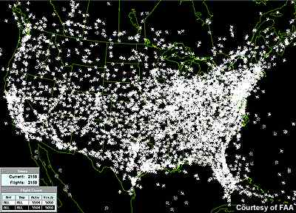
DENSITY:
HOW TIGHTLY PACKED
THE ATOMS ARE
Density
page 7

Slide 29
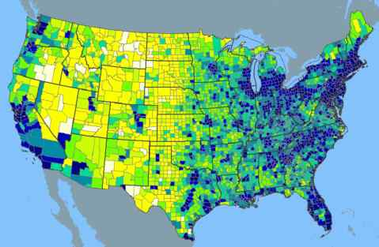
DENSITY:
HOW TIGHTLY PACKED
THE ATOMS ARE
Density
page 7

Slide 30
DENSITY:
HOW TIGHTLY PACKED
THE ATOMS ARE
When an object is heated, it
and the atoms become
packed. Therefore the object becomes
dense.
expands
less
Density
less
page 7

Slide 31
DENSITY:
HOW TIGHTLY PACKED
THE ATOMS ARE
When an object is cooled, it
and the atoms become
packed. Therefore the object becomes
dense.
contracts
more
Density
more
page 7

Slide 32
density
Density
temperature

Slide 33
What happens to the density of an object when it is split into smaller parts? why?
Density
nothing!
the atoms are still
packed the same
page 7

Slide 34
Density
What is the formula for density?
density = mass / volume
page 7
hint
ESRT: Earth Science Reference Table – Page 1

Slide 35
A rock has a mass of 240g and a
volume of 12cm³.
Showing all formulas and calculations,
determine the density of the rock.
Sample Problems
density = mass / volume
= 240g / 12cm³
page 7
= 20.0 g/cm³

Slide 36
The box below has a mass of 120g.
Showing all formulas and calculations,
determine the density of the box.
Sample Problems
2.0 cm
volume = L x W x H
10.0 cm
= 2.0cm x 2.0cm x 10.0cm
2.0 cm
= 40.0 cm³
density = mass / volume
= 120g / 40cm³
page 7
= 3.0 g/cm³

Slide 37
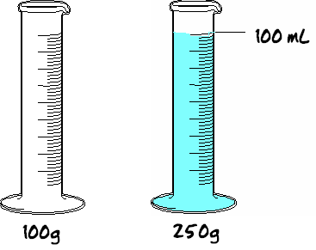
If the empty container has a mass of 100g and
the filled container has a mass of 250g.
What is the density of the liquid inside?
Show all work below.
mass of liquid
Sample Problems
250g – 100g = 150g
density of liquid
density = mass/volume
page 8
= 150g /100mL = 1.5 g/mL

Slide 38
Density of water:
4
Water is most dense at _______°C.
This is because water _______________ above
and below this temperature
expands
4°C

Slide 39
Density of water:
The density of water
when it is most dense is:
1.00 g/mL
hint
ESRT: Earth Science Reference Table – Page 1

Slide 40
Density of water:
Float or Sink
Any material with a density
less than water will
FLOAT

Slide 41
Density of water:
Float or Sink
Any material with a density
greater than water will
SINK

Slide 42
Density of water example:
If an object has a mass of 25g and a volume of 50mL, will it sink or float in liquid water?
D = m ÷ v
= 25g ÷ 50mL
= 0.5 g/mL
it will FLOAT

Slide 43
Phases of Matter & Density
During which phase of matter (solid,
liquid, or gas) are most materials:
most dense?
least dense?
solid
gas

Slide 44
DYNAMIC EQUILIBRIUM
A balance between opposing forces.
Small changes occur, but the overall system stays the same.

Slide 45
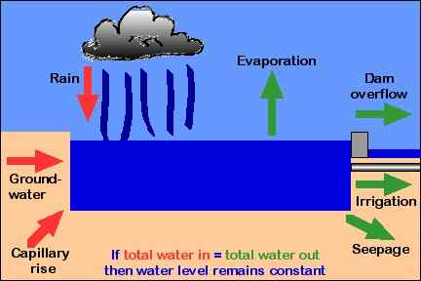
Dynamic Equilibrium
Give a real life, earth science example of a
system that is in dynamic equilibrium.

Slide 46
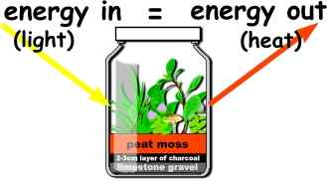
Dynamic Equilibrium
Give a real life, earth science example of a
system that is in dynamic equilibrium.

Slide 47
INTERFACE
A boundary between two things with different properties.

Slide 48
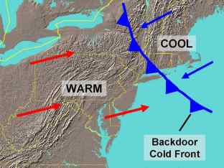
Interfaces
Give a real-life,
earth science example
of an interface.
fronts

Slide 49
Cyclic Events
Give three real-life, earth science, examples of cyclic events
phases of moon
yearly temperatures
sunspots
tides
sunrise & sunset

