Slide 1
Metamorphic Rocks Rocks & Minerals Notes: Page 10
©Mark Place, 2009-2010
www.LearnEarthScience.com

Slide 2
Metamorphic Rocks
Key Concept #1
How are metamorphic
rocks formed?
Please go to the
"Rock Cycle" on
Page 6 of the
ESRTS
extreme heat
and/or
pressure

Slide 3
Metamorphic Rocks
Key Concept #2
If melting occurs,
it is classified as
an
MELTING DOES NOT OCCUR!
Igneous Rock

Slide 4
Metamorphic Rocks: Key Concept #3
What is the difference between
Regional and Contact Metamorphism?

Slide 5
Regional Metamorphism
Large geographic area
Example:
where mountains form

Slide 7
Contact Metamorphism
small geographic area
Example:
when rocks come in
contact with magma

Slide 8
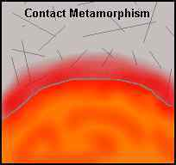

Slide 9
Metamorphic Rocks: Key Concept #4
Key Identifying Features of Metamorphic Rocks

Slide 10
Foliation
Image #1
Image #2
banding of minerals
usually black and white
Image #3

Slide 11
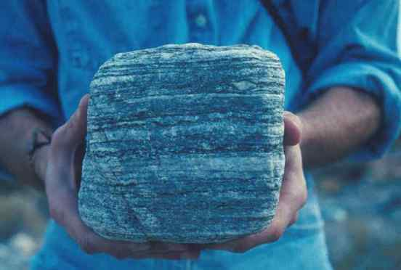

Slide 12
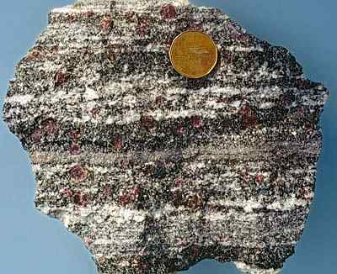

Slide 13
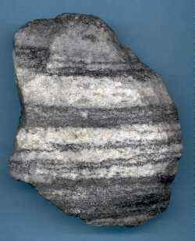

Slide 14
Distorted Structure
folded layers
Image #3
Image #1
Image #2

Slide 15
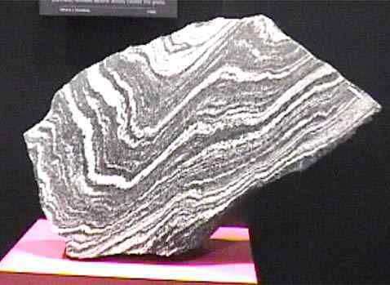

Slide 16
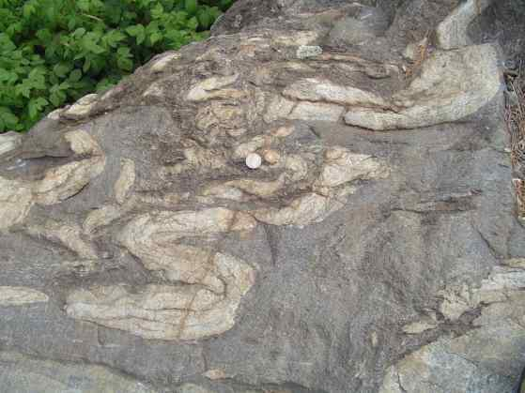

Slide 17
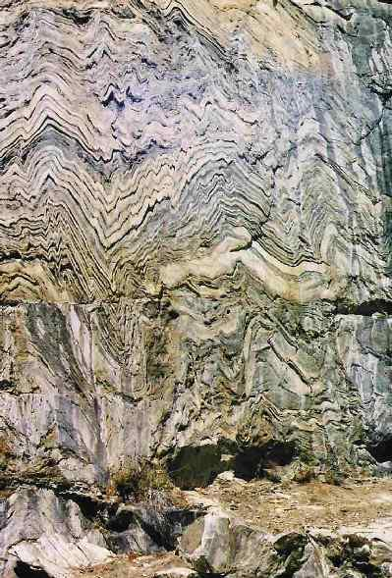

Slide 18
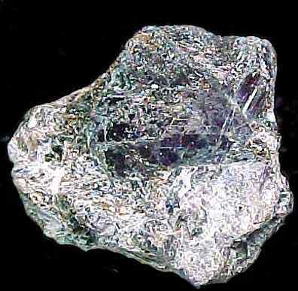
Key Identifier Minerals
Dark
Red
Color
Garnet
Shiny,
flaky
Mica

Slide 19
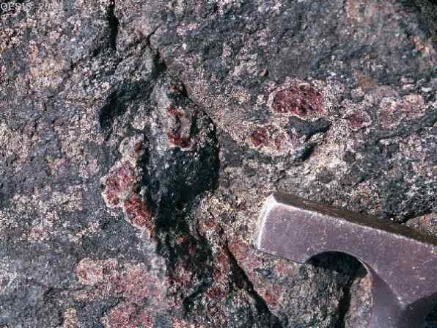

Slide 21
Please Answer the Questions on Page 11 Using Your Earth Science Reference Tables.

Slide 22
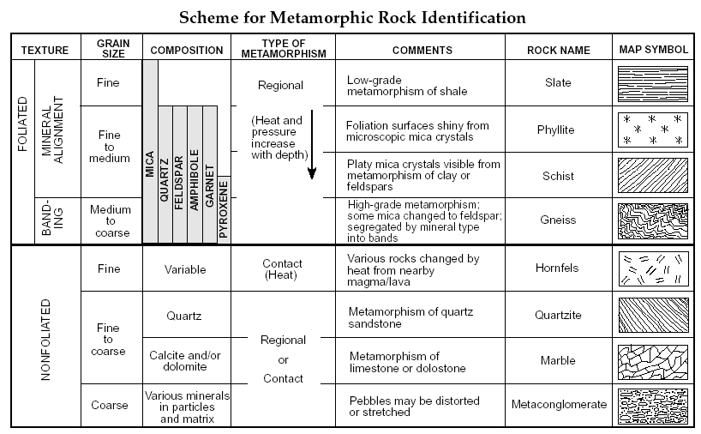
Answers on the Next Page

Slide 23
The Answers (Page 11): 1. Gneiss 2. Quartzite 3. Sandstone Shale Limestone
Stop and complete
the Metamorphic
Rock Lab

Slide 24
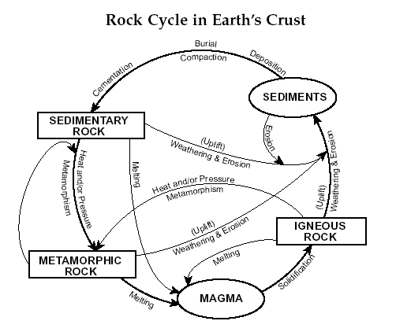
Earth Science
Reference Tables
Page 6

