Slide 1
Rocks & Minerals
NOTES Pages 1 - 3
©Mark Place, 2009-2010
www.LearnEarthScience.com

Slide 2
Key Concept #1
What is a mineral?
naturally occurring
inorganic
It is a
definite chemical composition
substance which has a
What would be the opposite of this?
man-made
organic
random composition
ESRT Mineral Chart Click Here

Slide 3
On to the next Concept

Slide 4
Key Concept #2
What causes minerals to have
different physical properties?
their internal arrangement of atoms

Slide 5
Key Concept #2
Give an example of two minerals which have
the same chemical composition but different
physical properties
Click Here
graphite & diamond

Slide 6
On to the next Concept

Slide 7
Key Concept #3
The Main Physical Properties
Used to Identify Minerals
Color
a poor indicator
minerals can be multiple colors
many minerals are the same color

Slide 8
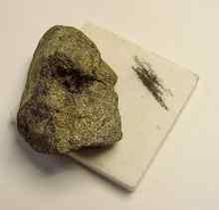
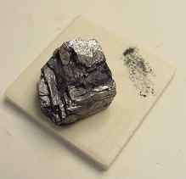
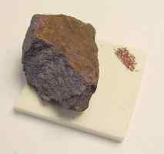
Key Concept #3
The Main Physical Properties
Used to Identify Minerals
Streak
the powder form of a mineral
more reliable than color

Slide 9
Key Concept #3
The Main Physical Properties
Used to Identify Minerals
Luster
how light reflects off a mineral
metallic
non-metallic
looks like a
metal
looks earthy, waxy,
greasy or brilliant

Slide 10
Key Concept #3
The Main Physical Properties
Used to Identify Minerals
Cleavage
the mineral breaks in a predictable pattern
because of its arrangement of atoms

Slide 11
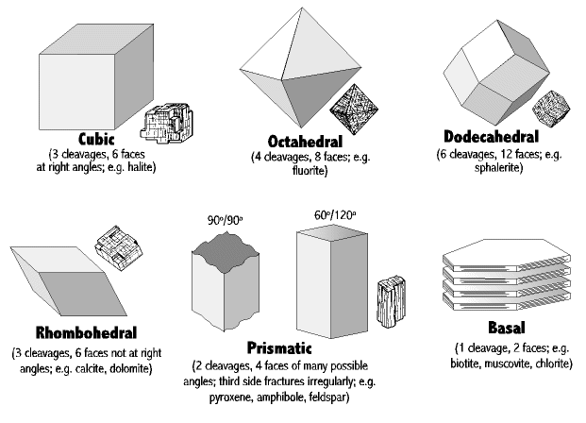
Examples of Cleavage

Slide 12
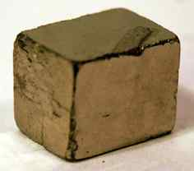
Examples of Cleavage

Slide 13
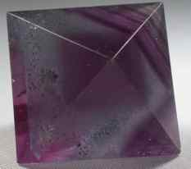
Examples of Cleavage

Slide 14
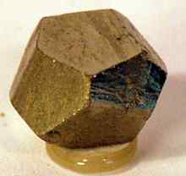
Examples of Cleavage

Slide 15
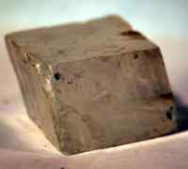
Examples of Cleavage

Slide 16
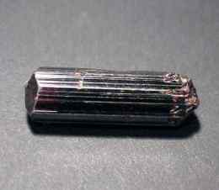
Examples of Cleavage

Slide 17
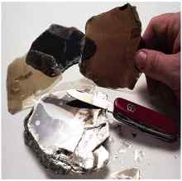
Examples of Cleavage

Slide 18
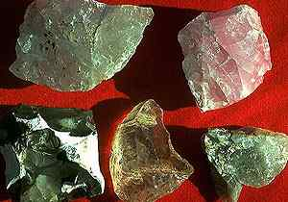
Key Concept #3
The Main Physical Properties
Used to Identify Minerals
Fracture
the mineral breaks randomly

Slide 19
Key Concept #3
The Main Physical Properties
Used to Identify Minerals
Hardness
resistance to being scratched
It is NOT the same as breaking!
For example:
You can break glass easily with steel.
However, steel will not scratch glass.

Slide 20
Key Concept #3
The Main Physical Properties
Used to Identify Minerals
Hardness
MOH’S SCALE OF HARDNESS
Hardness | Mineral | Hardness | Mineral
1 (softest) |  | 6
2 |  | 7
3 |  | 8
4 |  | 9
5 |  | 10 (hardest)
TALC
ORTHOCLASE
GYPSUM
QUARTZ
CALCITE
TOPAZ
FLUORITE
CORUNDUM
APATITE
DIAMOND

Slide 21
Key Concept #4
Minerals have a definite chemical composition.
What two elements, by mass, make up the greatest
percentage of the Earth’s crust?
oxygen
silicon

Slide 22
Key Concept #4
Minerals have a definite chemical composition.
These two elements combine to form compounds called
silicates (SiO₄)

Slide 23
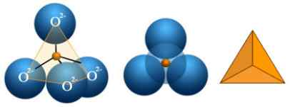
Key Concept #4
Minerals have a definite chemical composition.
They combine in a specific structure called a:
silicon-oxygen tetrahedra

Slide 24
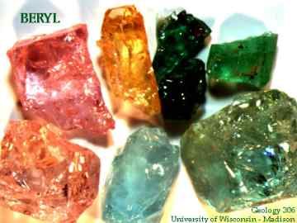
One Mineral,
Many Colors

Slide 25
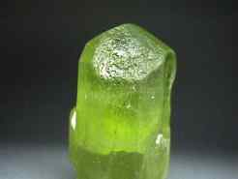
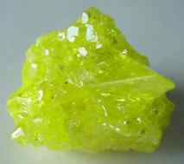
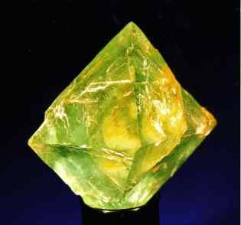
Different Minerals
Same Color

