Slide 1
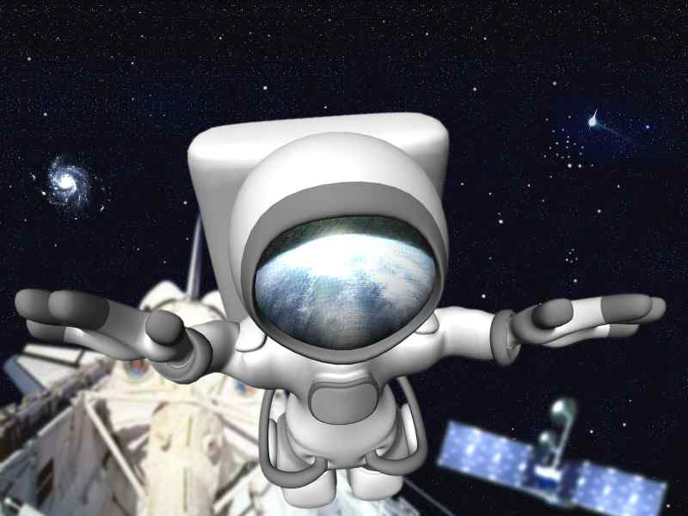
The Moon
Astronomy
Page 9
©Mark Place, 2009-2010
www.LearnEarthScience.com

Slide 2
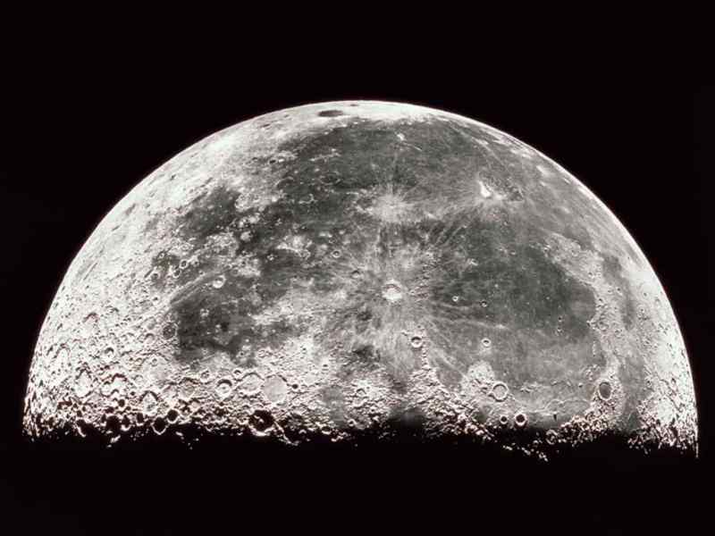
Craters
Why so many?
What are these?
No atmosphere
Why is Earth not like this?
weathering, erosion, atmosphere

Slide 3
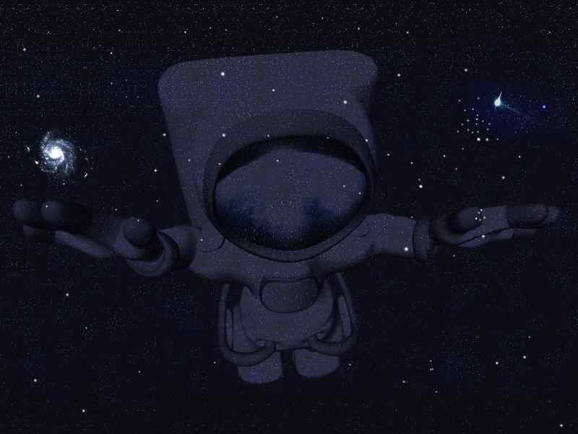
Phases
of the
Moon
Astronomy
Page 10

Slide 4
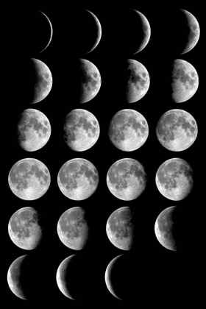
What causes
the phases
of the moon?
The moon's
revolution
around Earth.

Slide 5
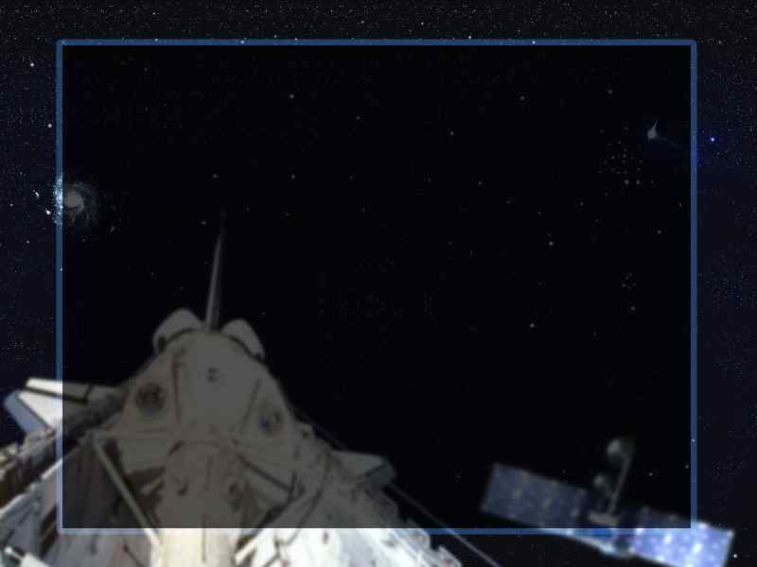
How long does
one revolution of
the moon take?
27.3 days
How long does
one rotation of
the moon take?
ESRTs p15

Slide 7
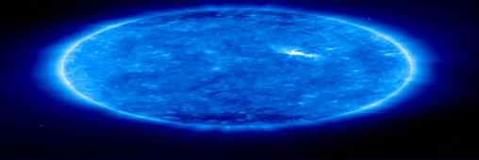
What phenomenon
does this explain?
We only ever see one
side of the moon.

Slide 8
Why does the moon
rise later each day?
because as the Earth
rotates, the moon
revolves

Slide 9
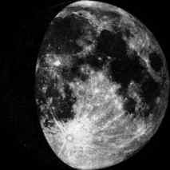
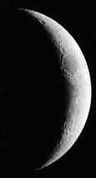
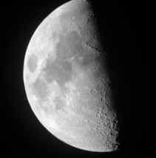
What phase of the moon is this?
New
Gibbous
New
Crescent
3rd
Quarter

Slide 10
Approximate Times of Moonrise and Moonset
 | moonrise | moonset
new moon | 06:00 AM | 06:00 PM
waxing crescent | 09:00 AM | 09:00 PM
first quarter | 12:00 PM | 12:00 AM
waxing gibbous | 03:00 PM | 03:00 AM
full moon | 06:00 PM | 06:00 AM
waning gibbous | 09:00 PM | 09:00 AM
third quarter | 12:00 AM | 12:00 PM
waning crescent | 03:00 AM | 03:00 PM
new moon | 06:00 AM | 06:00 PM
How many hours is the
moon visible each day?
12 hours

Slide 11
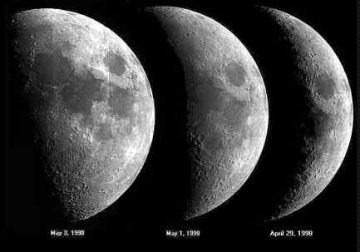
What is "waxing"?
more of the moon's
surface can be seen

Slide 12
What is "waning"?
less of the moon's
surface can be seen

Slide 13
The phases of the
moon are what type
of event?
Cyclic

Slide 14
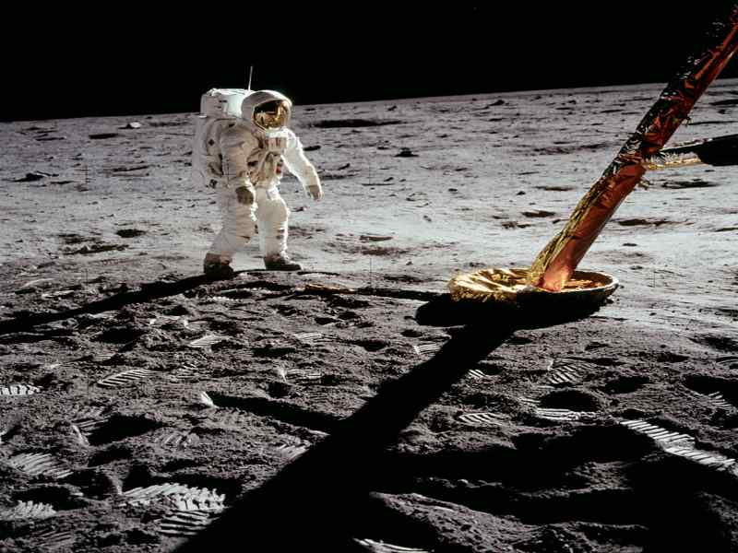
Going to the Moon

