Slide 1
Plate Tectonics
Tectonics NOTES
page 6
©Mark Place, 2009-2010
www.LearnEarthScience.com

Slide 2
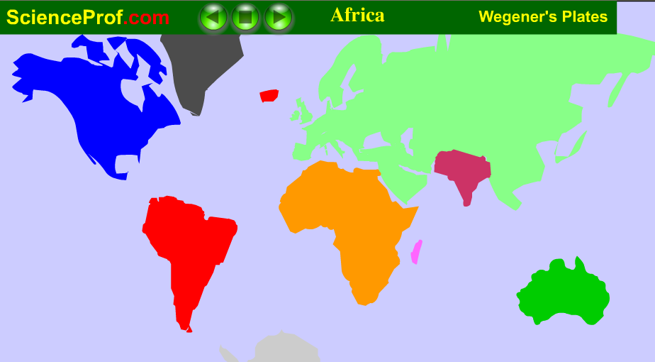
What is the Theory of Continental Drift?

Slide 3
What is the Theory of Continental Drift?
Alfred Wegner, 1915
The continents were once a super-continent called Pangea
the continents are plowing through the ocean floors---most people didn’t believe this

Slide 4
What evidence supports this theory?
Africa & South America look like they fit together
similar fossils, rocks, and glacial striations

Slide 5
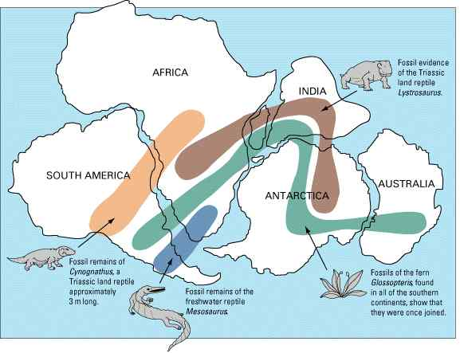

Slide 6
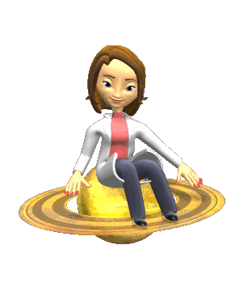
On to the
next question...

Slide 7
What is the Theory of Plate Tectonics?
Earth's crust is made up of plates that ride on top of the asthenosphere
The plates move due to convection currents in the mantle

Slide 8
What evidence supports this theory?
distribution of earthquakes and volcanoes
sea-floor spreading

Slide 9
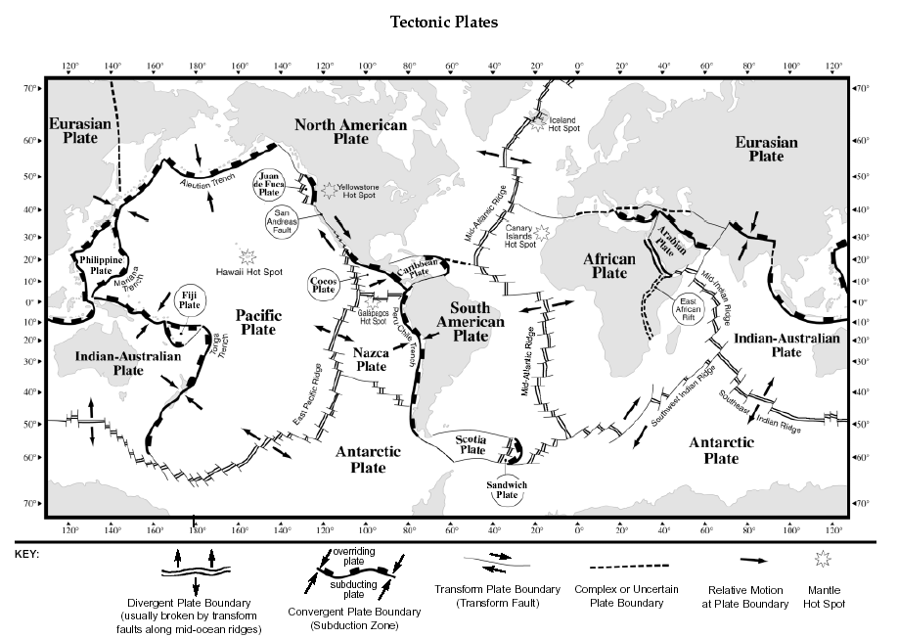
ESRTs Page 5

Slide 10
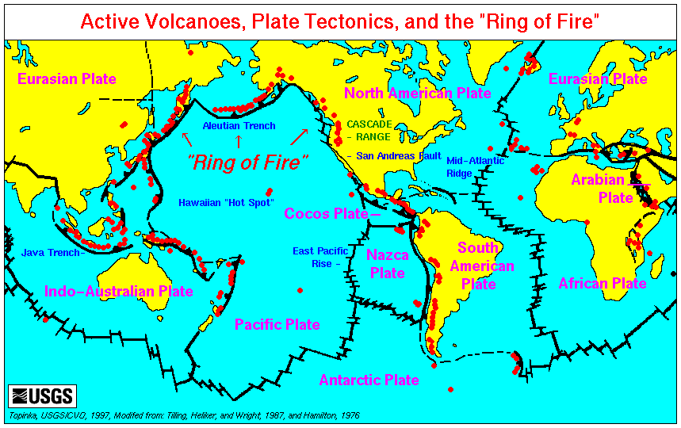

Slide 11
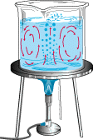
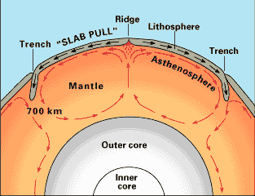

Slide 12
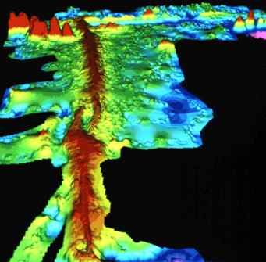
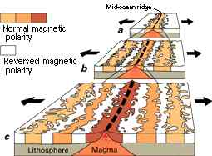

Slide 13
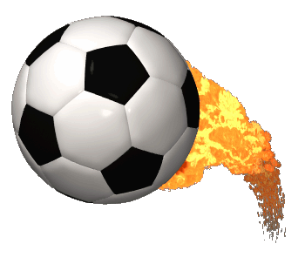
On to the
next question...

Slide 14
How do oceanic and continental crust compare with regard to thickness and density?
 | continental | oceanic
Density (ESRTs pg 10)
thickness
high
low
thick
thin

Slide 15
On to the
next question...

Slide 16
What are the primary rocks which make up the continental and oceanic crusts?
continental crust | oceanic crust
Low-density, light-
colored, coarse-
grained, felsic, igneous
rock
High density, dark-
colored, fine-grained,
mafic igneous rock
granite
basalt

Slide 17
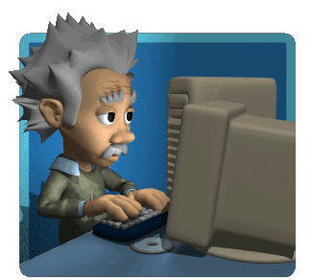
On to the
next question...

Slide 18
What are these types of plate boundaries?
What are the key
characteristics for each?
Give an example of where each can be found.

Slide 19
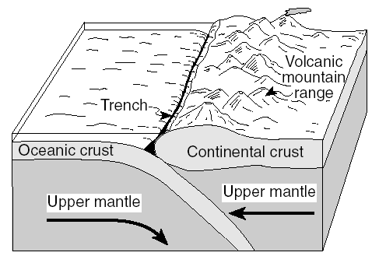
oceanic-continental convergent boundary
trenches, volcanoes, deep earthquakes
Peru-Chile Trench

Slide 20
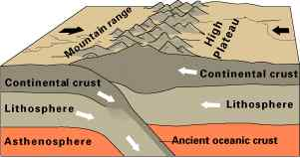
continental-continental convergent boundary
mountain building
Himalayas

Slide 21
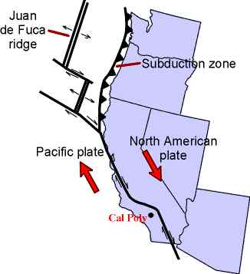
transform fault
slide past one another
shallow earthquakes
San Andreas Fault

Slide 22
divergent plate boundary
new crust is made
Mid-Atlantic Ridge

Slide 23
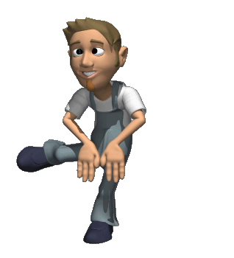
On to the
next question...

Slide 24
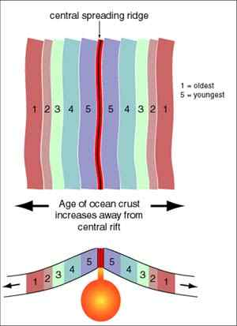
What happens to the age of oceanic crust as distance increases from a ridge?

Slide 25
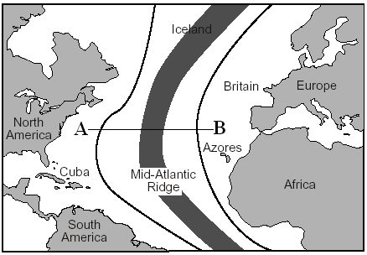
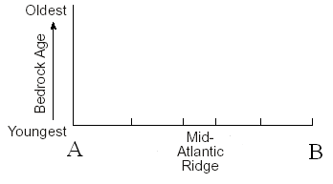

Slide 26
Explain how magnetic data can be used to show that oceanic crust is diverging at ridges. Use the diagram below to help explain your answer.
as new crust is made at ridges, the ferrous minerals (Fe) align according to where the magnetic poles are located
same pattern on opposite sides of the ridge
proves sea-floor spreading

Slide 27
