Slide 1
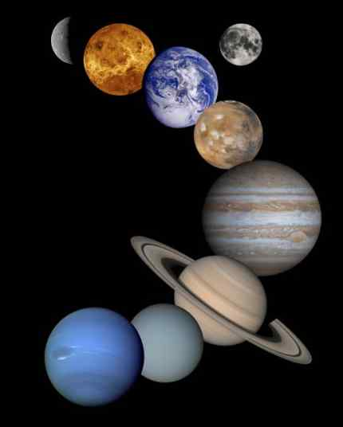
Our
Solar
System
©Mark Place, 2009-2010
www.LearnEarthScience.com

Slide 2
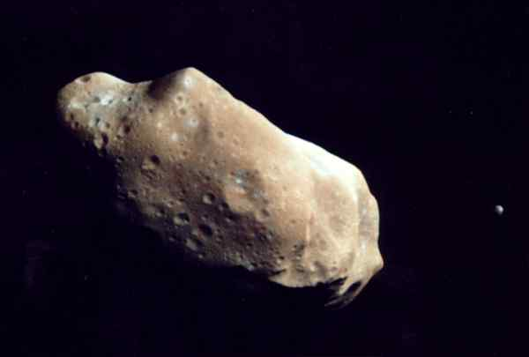
Asteroids
rocky objects with round or irregular shapes
lie in a belt between Mars and Jupiter
The total mass of all the asteroids
is less than that of the Moon.

Slide 3
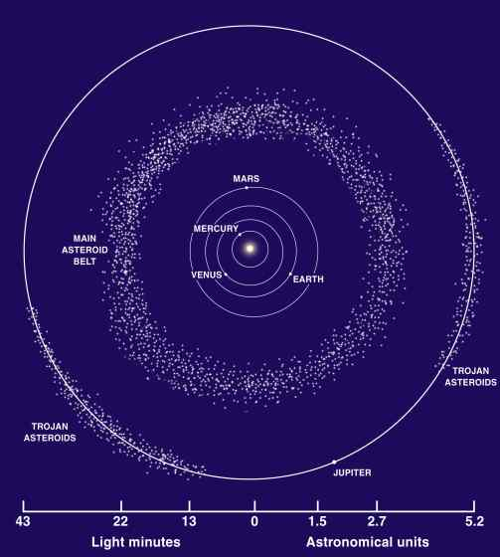

Slide 4
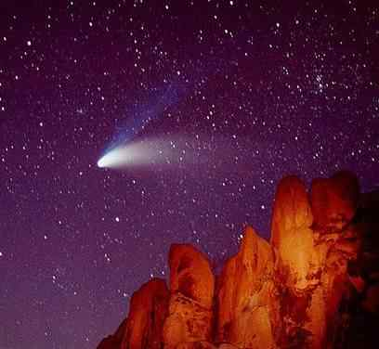
only visible when
they are close to
the sun

Slide 5
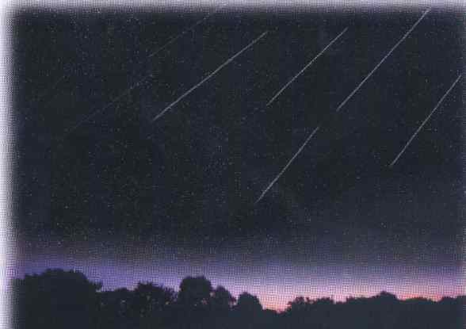
shooting stars

Slide 6
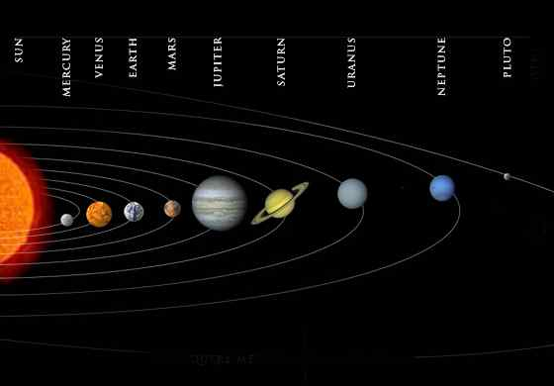
The Planets

Slide 7
Draw a line across the table between
the terrestrial and jovian planets and label.

Slide 8
Which are more dense?
Jovian or terrestrial

Slide 9
Which have more moons ?
Jovian or terrestrial

Slide 10
Which have longer periods of revolution?
Jovian or terrestrial

Slide 11
Which are larger in size on average ?
Jovian or terrestrial

Slide 12
Which planet has the longest day?
Venus

Slide 13
Which planet has the longest year?
Neptune

Slide 14
How are the orbits of the
planets described?
slightly, eccentric ellipse
eccentricity website

Slide 15
Which planet has the least
perfectly circular orbit?
Mercury

Slide 16
Which planet has the most
perfectly circular orbit?
Venus

Slide 17
Calculate the eccentricity
of the ellipse below:
length of major axis
Formula:
eccentricity = distance between foci
length of major axis

Slide 18
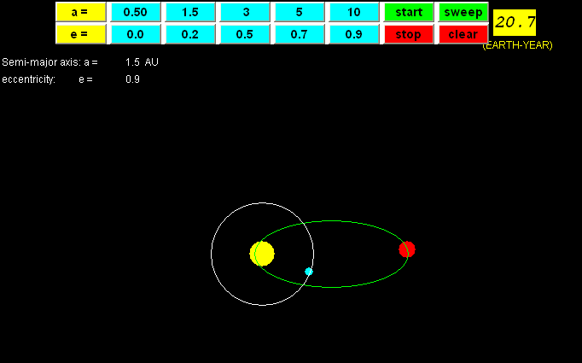
When does a planet move
slowest in its orbit?
When furthest
from Sun
When does a planet move
fastest in its orbit?
When closest
to Sun

Slide 19
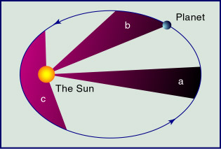
Kepler's Second Law
Area A
=
Area B
=
Area C
eccentricity website

Slide 20
Explain the difference between
the geo- and helio-centric
models of the solar system.
Helio-centric
Geo-centric
Earth-
centered
Sun-
centered

