Slide 1
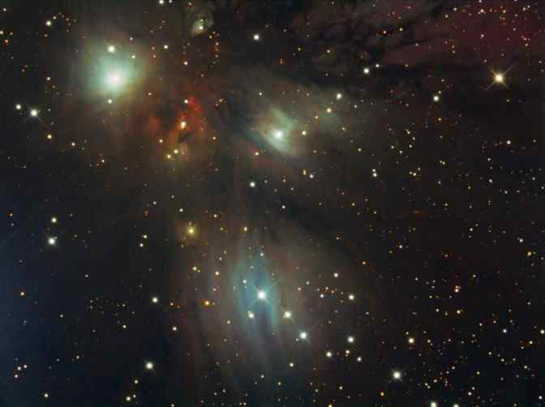
Astronomy Notes
Page 5
Stars
©Mark Place, 2009-2010
www.LearnEarthScience.com

Slide 2
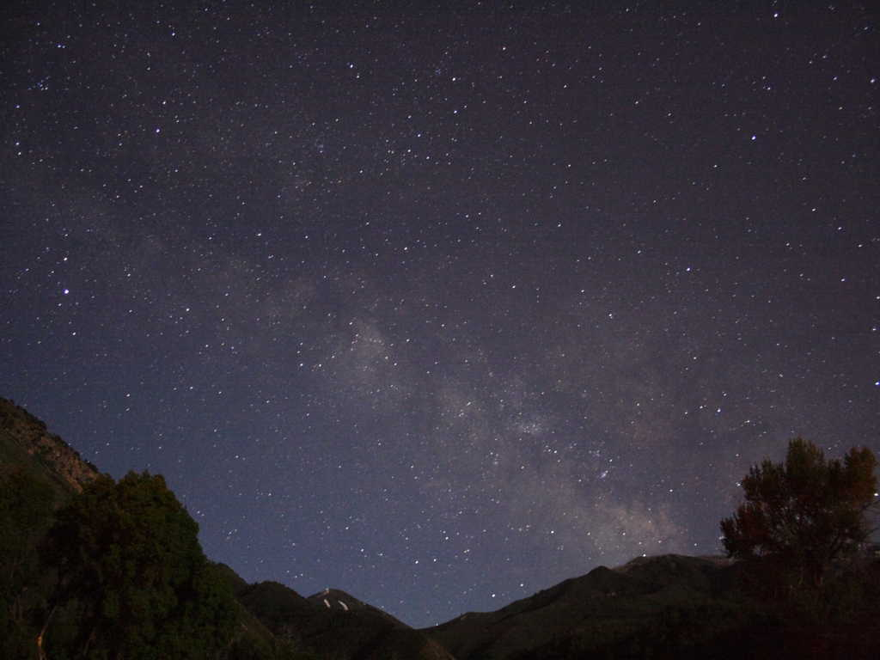
What are the
main classifications
of stars?
Blue Supergiants
Red Giants
Main Sequence
White Dwarfs
Red Dwarfs
ESRTs p15

Slide 3
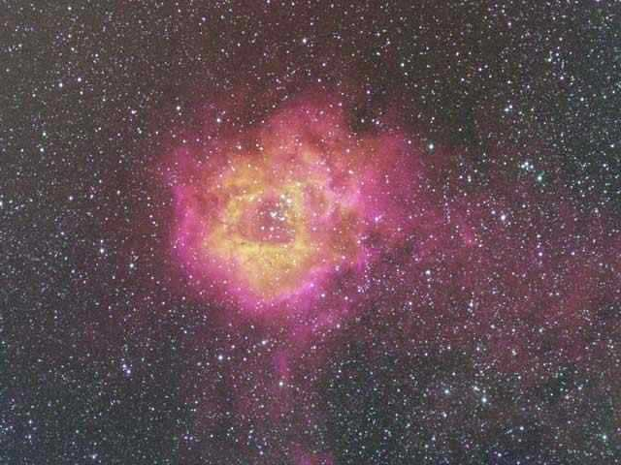
What two
characteristics are used to
classify stars?
Luminosity
Temperature
ESRTs p15

Slide 4
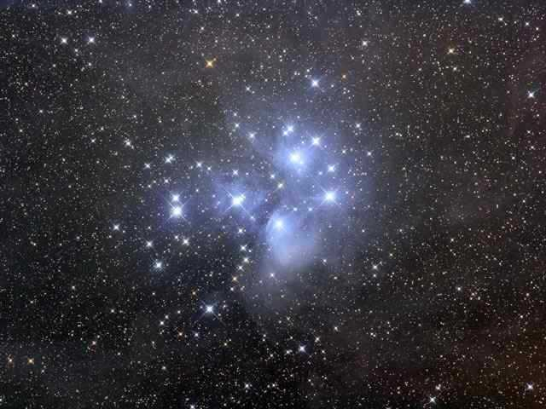
What type of star is our
Sun classified as?
ESRTs p15
Main Sequence
Circle where it is on the chart

Slide 5
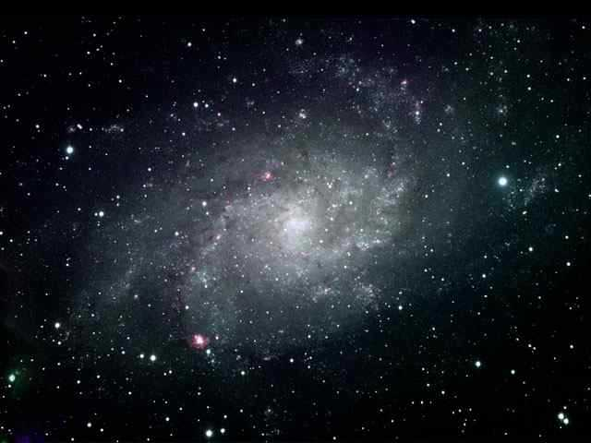
Shade the chart where all of the
stars are hotter than our sun.
Draw a line on the chart which
separates those stars brighter
than our sun and those less bright.
ESRTs p15

Slide 6
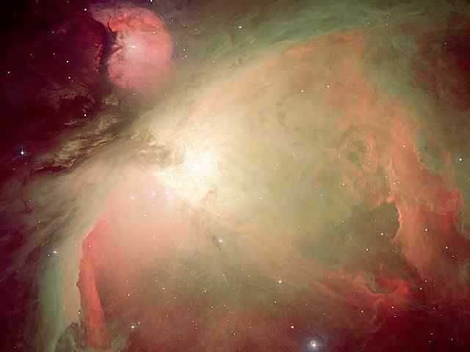
Betelgeuse is
Red
What color
are the
stars in the
constellation
Orion?
Rigel is
Blue
ESRTs p15

Slide 7
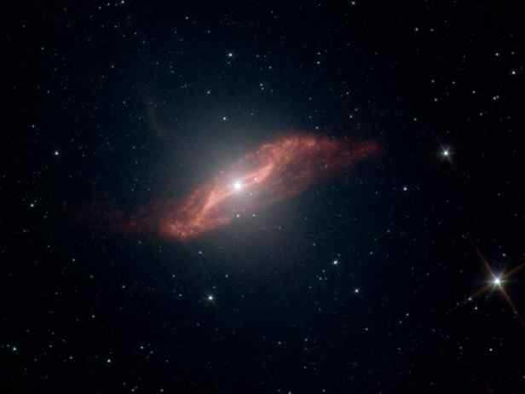
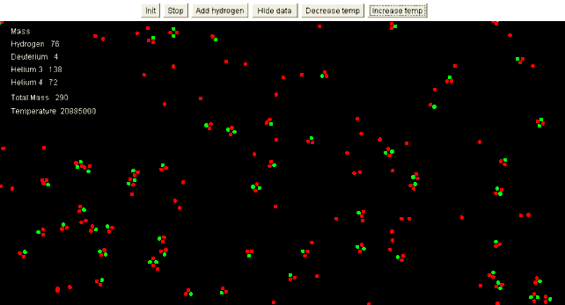
How do stars generate their energy?
Hydrogen
Helium
Hydrogen
Nuclear Fusion

Slide 8
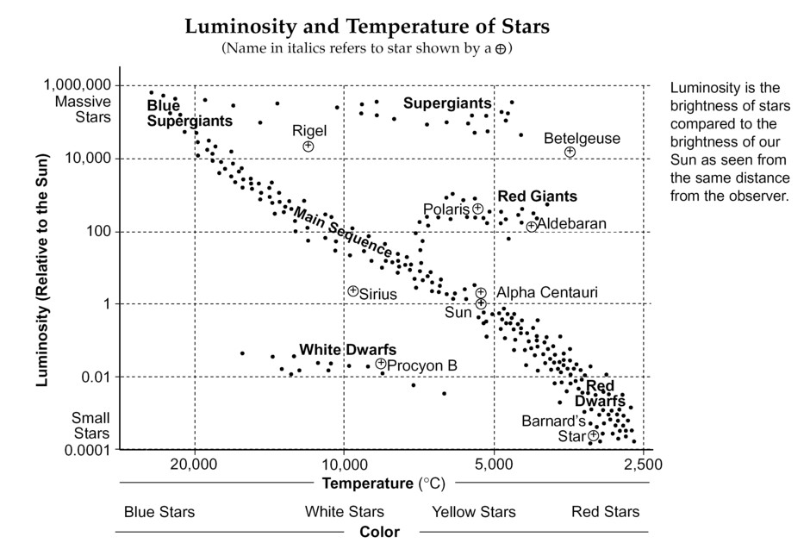

Slide 9
