Slide 1
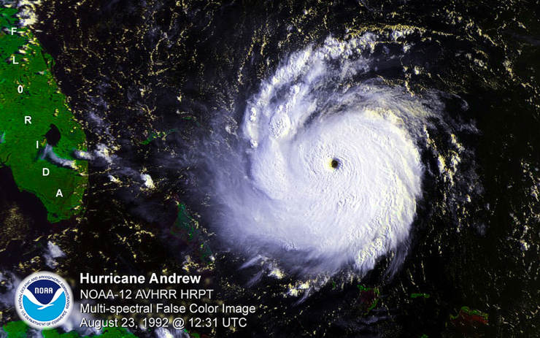
Weather
©Mark Place, 2009-2010
www.LearnEarthScience.com

Slide 2
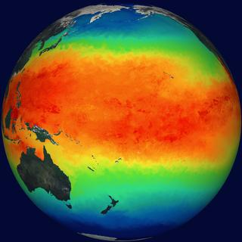
weather basics
Where does the energy for weather originate?
the uneven
heating
of the Earth’s
surface

Slide 3
weather basics
In the US, the general direction that weather systems
move is toward
the
northeast

Slide 4
Station Models
Please go to page 13 of the
ESRTs
Temperature and
dewpoint are measured in
degrees _______
F

Slide 5
Cloud Cover
Temperature
76
138
Wind Direction
&
Speed
..
Current Weather
-30\
55
Dewpoint
Barometric
Trend
Barometric
Pressure

Slide 6
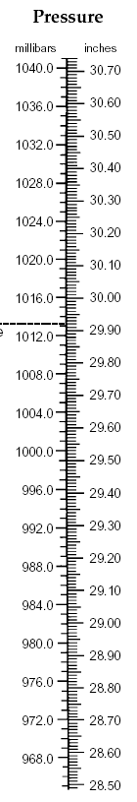
Barometric
Pressure
138
Add a decimal between the last two digits
13.8
Add a 9 or 10 in front to fit on the scale
(ranges from 950.0 to 1050.0)
1013.8

Slide 7
Station Model
Practice

Slide 8
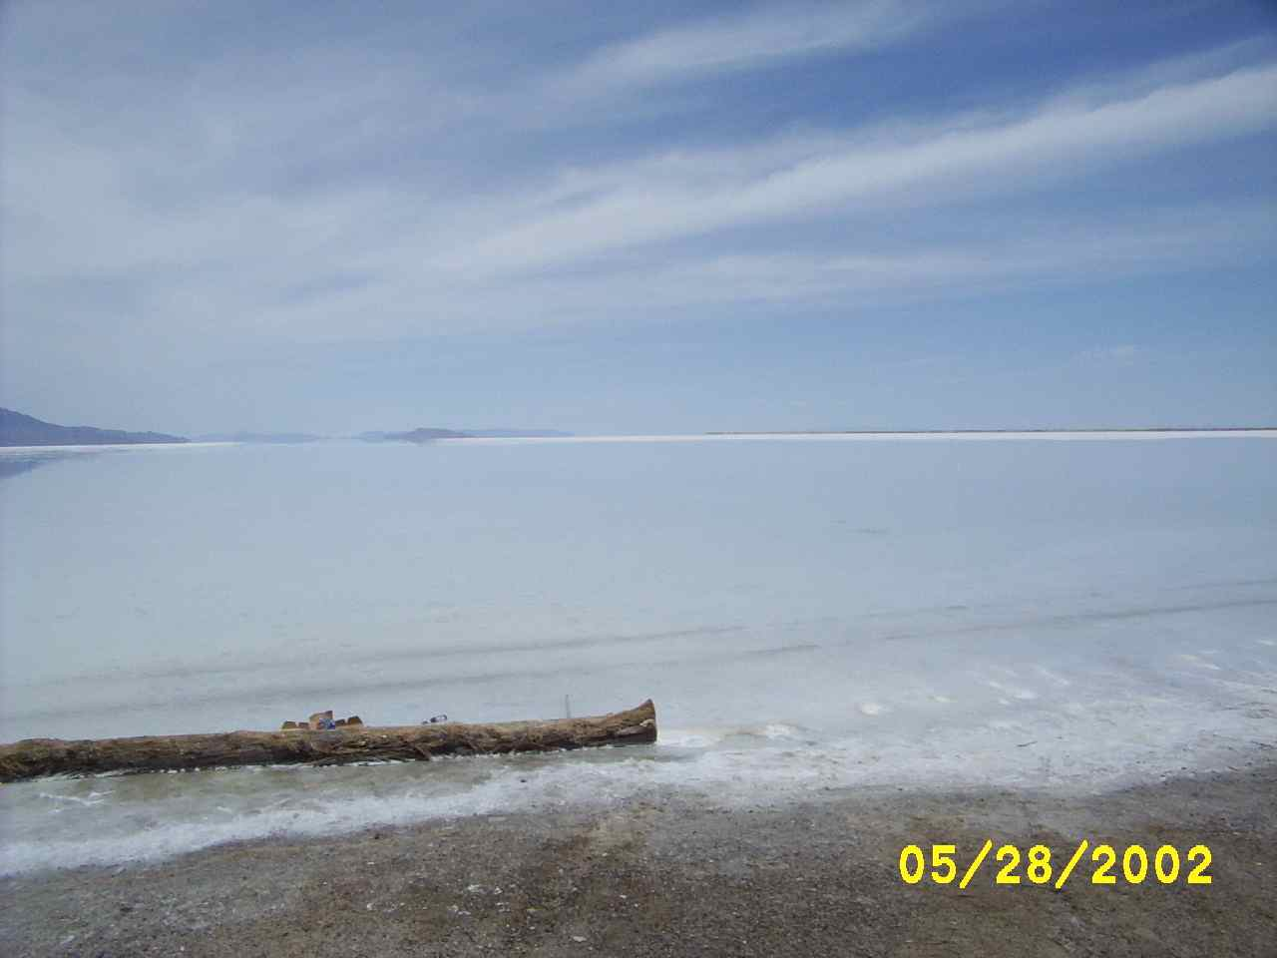
Evaporation Rates
Relative Humidity
Temperature
Surface Area

Slide 9
Temperature
Direct
Relationship
as temperature increases,
the rate of evaporation
increases

Slide 10
Surface Area
Direct
Relationship
as surface area increases,
the rate of evaporation
increases

Slide 11
Relative Humidity
Indirect
Relationship
as the air becomes more saturated,
the rate of evaporation
decreases

Slide 12

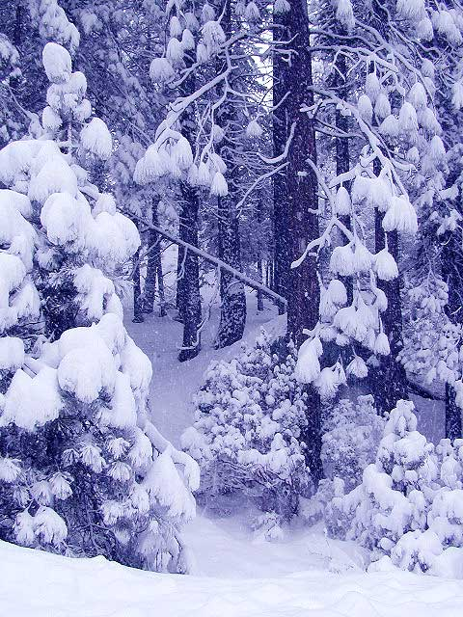
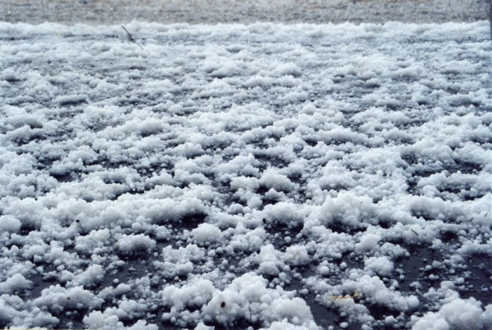
What natural process
cleans the atmosphere?
Rain
precipitation
Snow
Hail

Slide 13

Cloud Formation

Slide 14
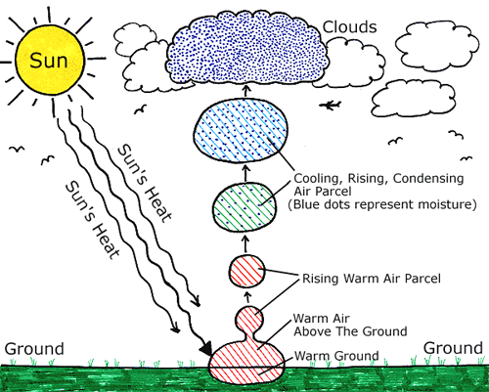
Cools to the
dewpoint
Expands
Warm
Air Rises

Slide 15

Clouds are likely to form when:
The air is saturated and rising
The temperature is at the dewpoint
Condensation nuclei are available

Slide 16
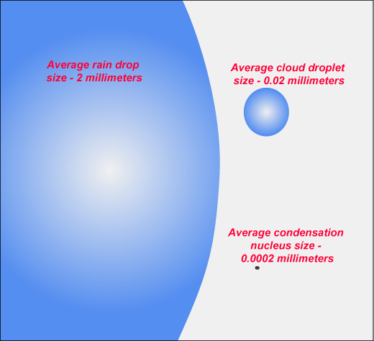

Slide 17
As air temperature increases
the air can hold
more water

Slide 18
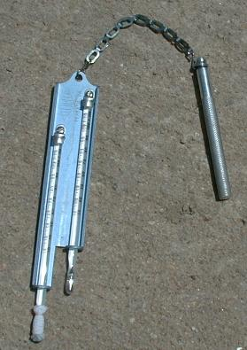
Sling Psychrometer
Dry bulb measures
air temperature
Wet bulb temp is
lower due to evaporation

Slide 19
Using the charts on page 12 of the ESRTs, calculate the relative
humidity and dew point using the following information.
Dry Bulb | Wet Bulb | Difference | Dew Point | Relative Humidity (%)
14 | 10 | 4
20 |  | 5
30 |  |  | 19
18 |  |  |  | 56
6
60
15
12
58
23
7
55
13
5
9
Dewpoint Chart
RH Chart

Slide 20
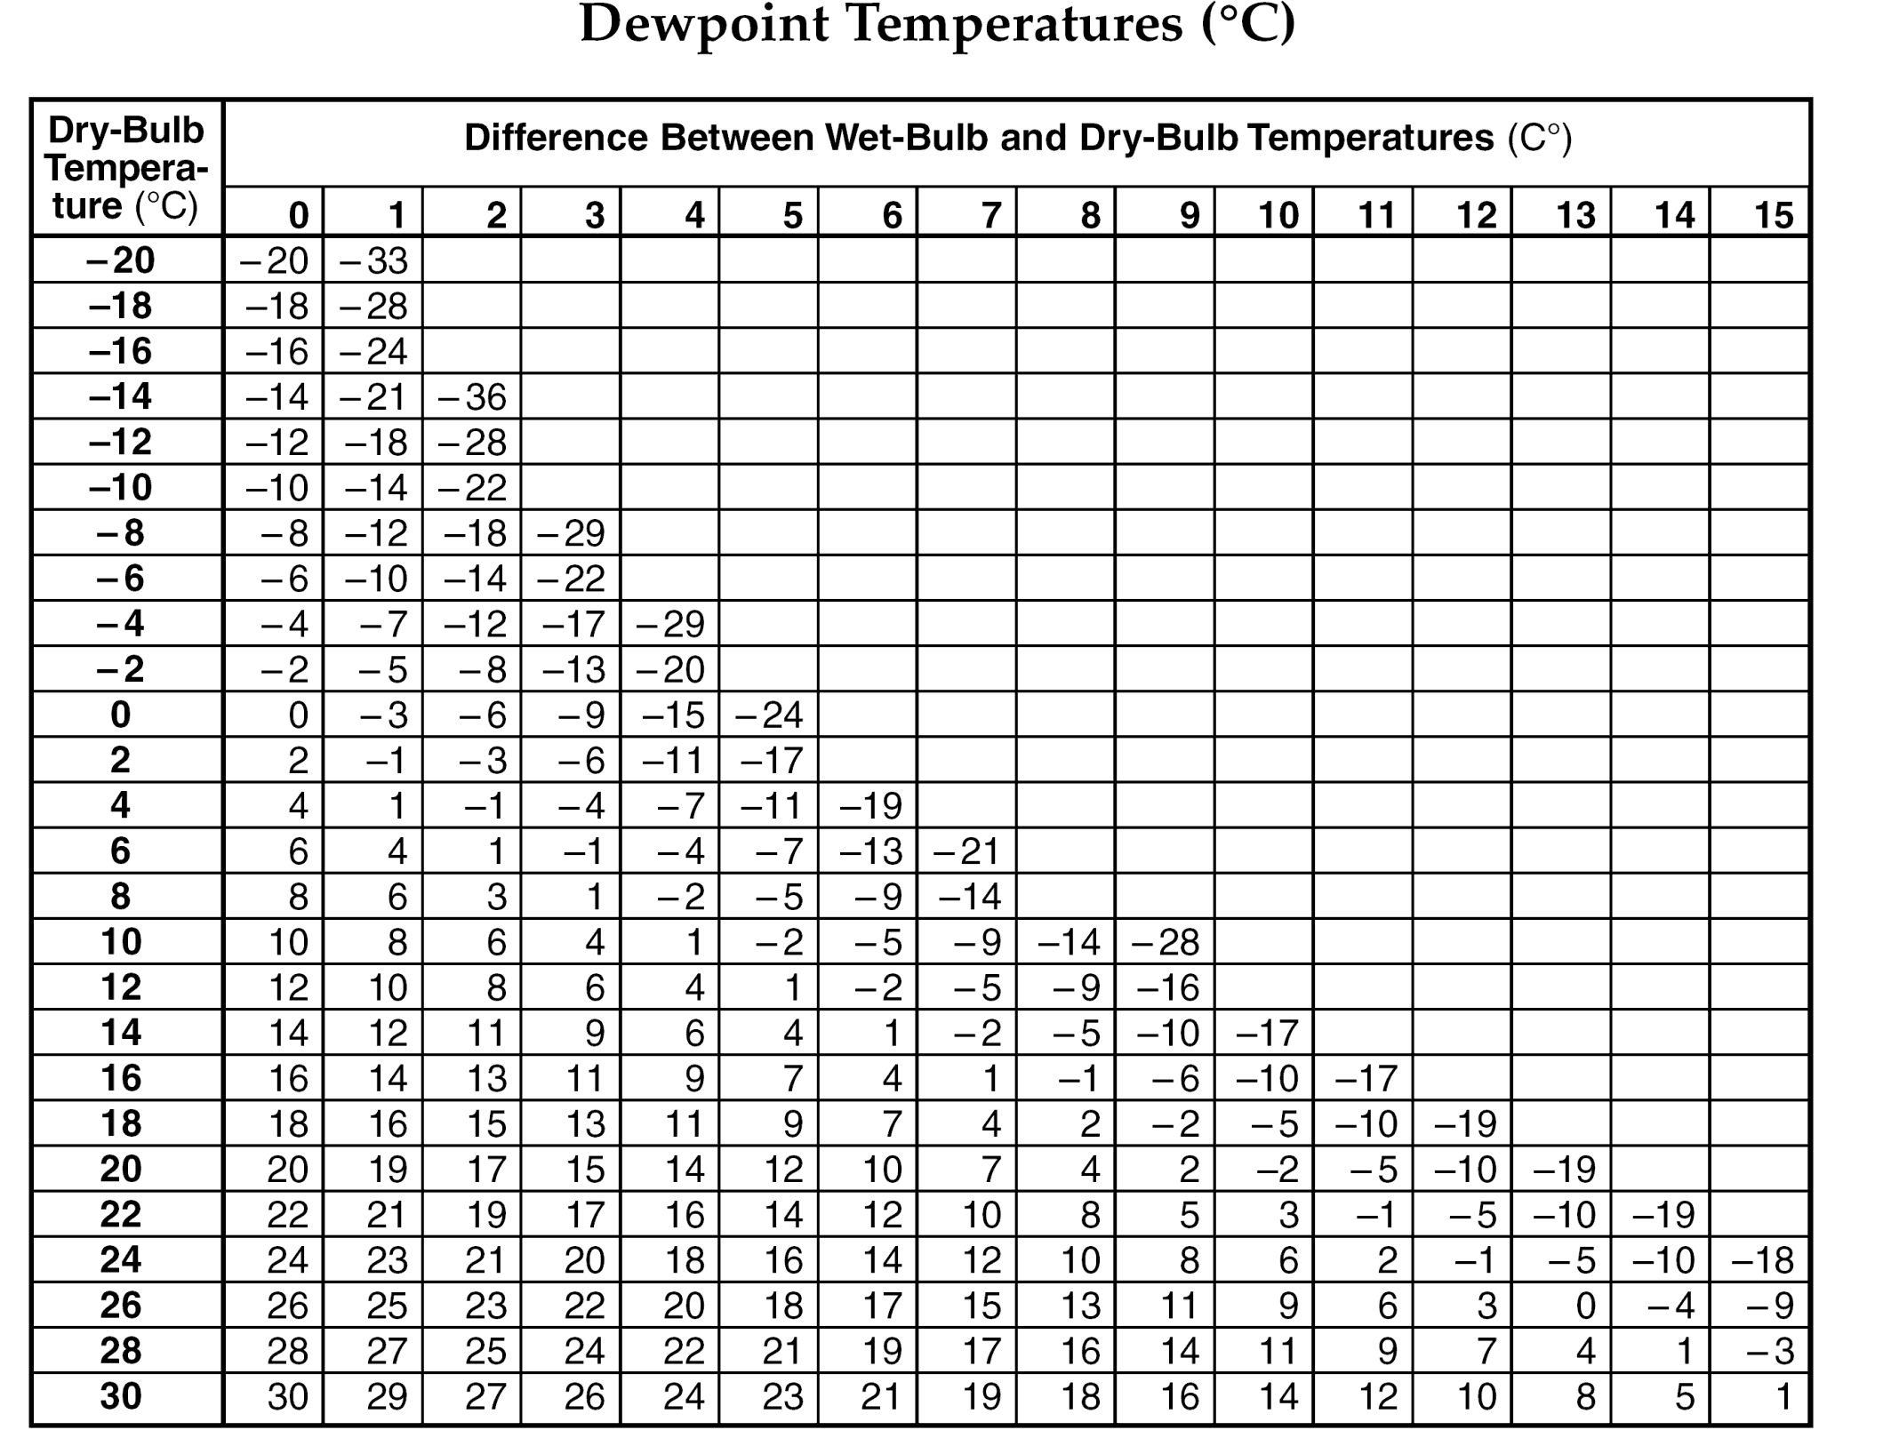

Slide 21
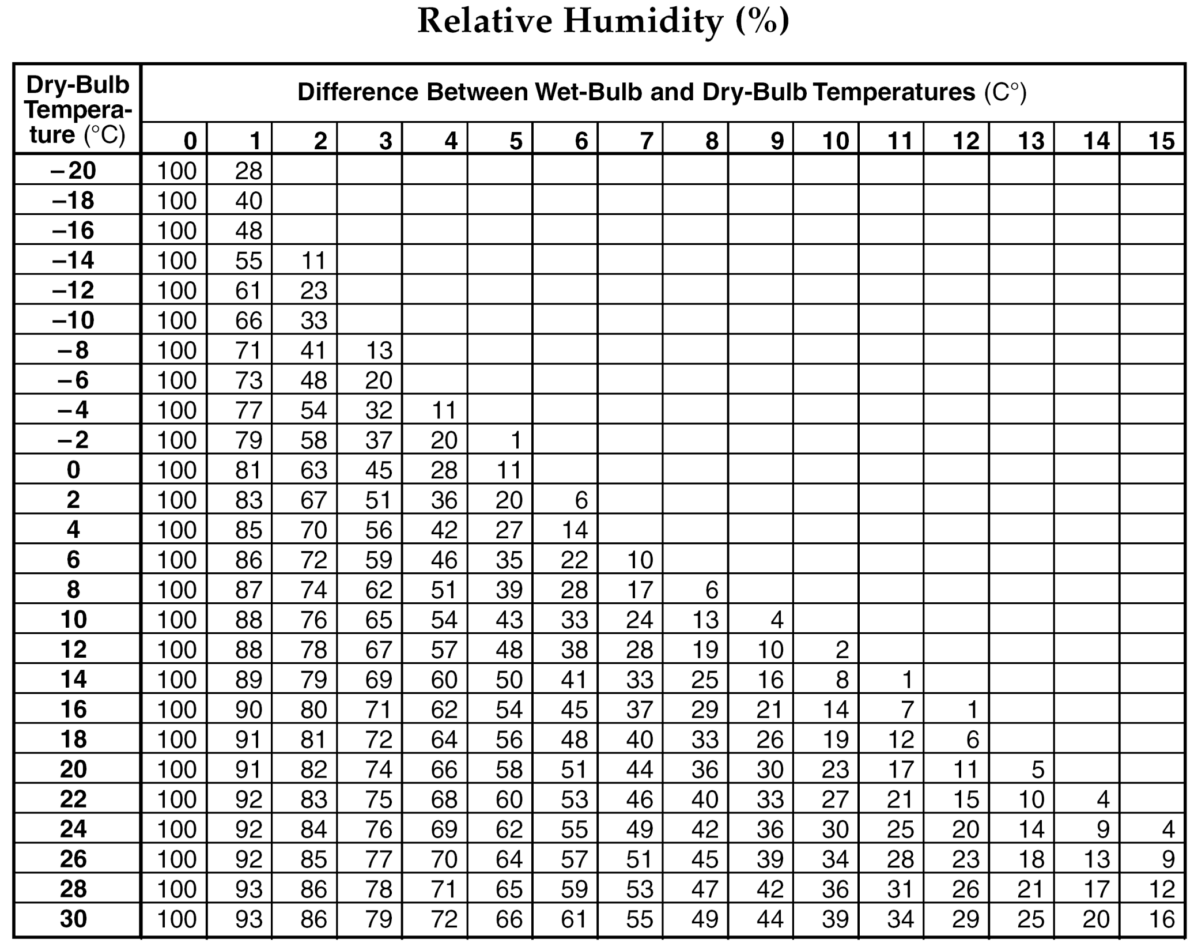

Slide 22
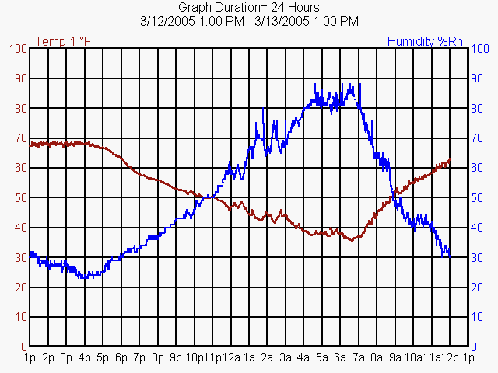
Relative Humidity
vs
Air Temperature
Indirect
Relationship
as temp increases
RH decreases

Slide 23
As dew point increases,
the amount of
moisture in the air
INCREASES

Slide 24
As temperature
and
dewpoint get closer together,
the probability of precipitation
INCREASES

Slide 25
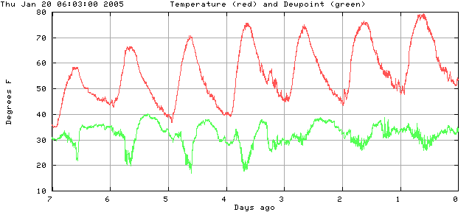
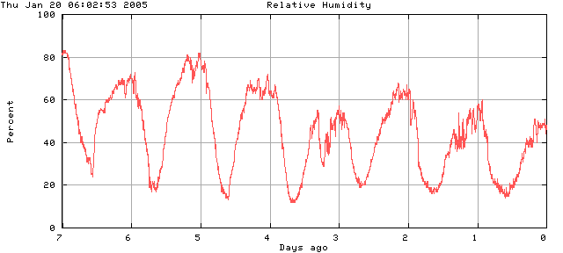

Slide 26
Which has the greatest
probability of precipitation?

